Slide 1
RAINING CVES ON WORDPRESS PLUGINS
WITH SEMGREP
Sheeraz Ali | Shreya Pohekar

Slide 2
Syed Sheeraz Ali
Shreya Pohekar
(Hack the box)
(Hackerone)

Slide 3
Index
01
Codevigilant
07
Exploring the Automaton
02
Why Wordpress was a target
08
Story of XSS Bomb and Demo
03
Pentest Approach
09
Developers misconception
04
What is semgrep
10
Developers best practices
05
Semgrep Usage and Rules
11
Future possibilities
06
Refining the semgrep rules

Slide 4
The Codevigilant Project!

Slide 5
Why Wordpress was chosen as a Target?!!
Semgrep's latest support for PHP
Wordpress being a globally used CMS

Slide 6
The Pentesting Approach
Static Code Analysis
02
Moving from code to feature
03
Moving from feature to code

Slide 7
What is Semgrep ?
Semgrep is an Open Source Tool for doing Static Code Analysis at ludicrous speed. Semgrep has support for 17+ languages. Few to mention are python, java, go. Semgrep allows writing customised rules specific to our use-case. It can be either used to hunt vulnerabilities or enforce code guardrails.

Slide 8
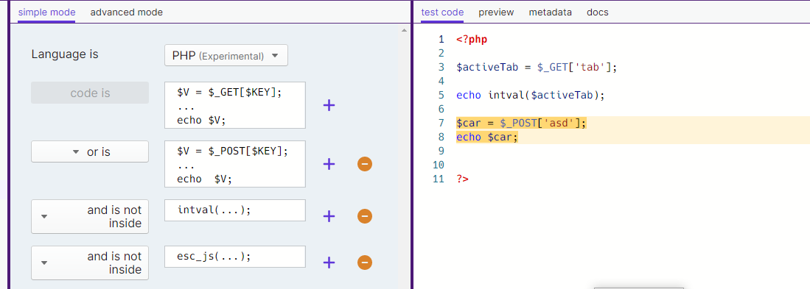
Semgrep Usage
https://semgrep.dev/editor

Slide 9
Semgrp Rule as a YAML file
rules:
- id: my_pattern_id
patterns:
- pattern-either:
- pattern: |
$V = $_GET[$KEY];
...
echo $V;
- pattern: |
$V = $_POST[$KEY];
...
echo $V;
- pattern-not-inside: intval(...);
- pattern-not-inside: esc_js(...);
message: Semgrep found a match
languages: [php]
severity: WARNING
To be shown - Demo video

Slide 10
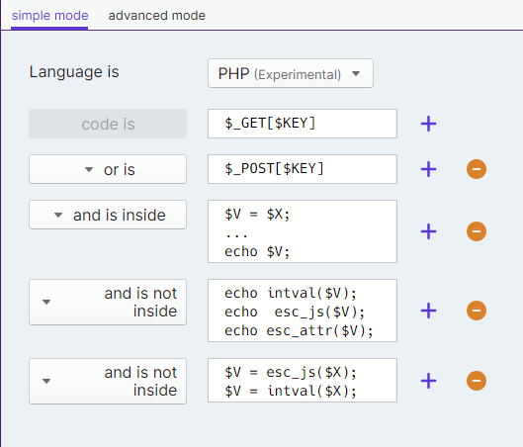
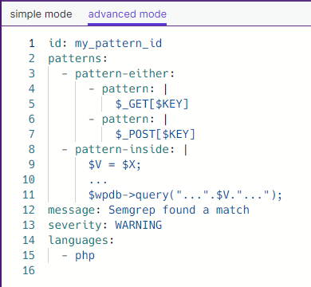
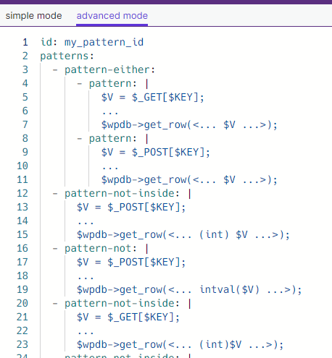
Refining the Rules and Writing the more complex ones
Wrote rules from the patterns identified via plugin pentest.

Slide 11
Exploring The Automation
Escalation of the vulnerability with various different user roles and privileges.
WordPress vulnerabilities grow on trees.
Report Generator

Slide 12
The Making of XSS Bomb
Why did we made it? 4000+ plugins in semgrep output was an insane number
How did we made it? Lets talk about our success and failure stories
What was the outcome? Doing some extra work to get rid of redundant work!

Slide 13
XSS Bomb Demo
- How does it works actually
- The speed of the tool
- The language used
- XSS validator GXSS

Slide 14
Developer's Misconception !
Instances when a developer tried to protect from XSS
Tried to protect from SQLi but it was still vulnerable to XSS
Where the filters protected against XSS but still vulnerable to SQLi

Slide 15
Developer's Best-Practices
Usage of Nested Filters
Coding best practices such as
Output Encoding for Various HTML Contexts
Output Encoding for URL Contexts
usage of wp-magic quotes

Slide 16
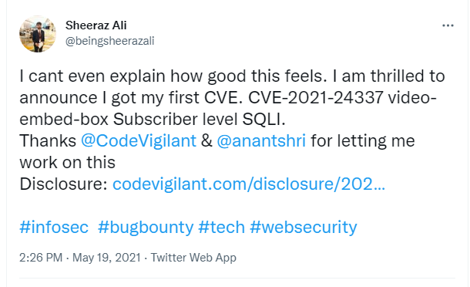
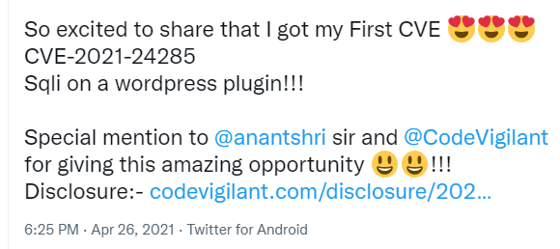

Slide 17
Yes The 48 CVEs.....
However, this is not the end!!!
The Future Possibilities
Hunting for themes or a new PHP CMS altogether
Rules for various vulnerability
Improving the tool to handle multiple scenarios
Doing automation wherever possible

Slide 18
Thank
You

Slide 19
Questions ?

Slide 20
References..
Twitter Sheeraz Shreya
https://github.com/KathanP19/Gxss
https://github.com/CodeVigilant/codevigilant_semgrep_rules
https://codevigilant.com/author/shreya_pohekar/
https://codevigilant.com/author/syed_sheeraz_ali/
https://shreyapohekar.com/blogs/dont-just-sanitize-but-also-escape-a-fable-of-sanitize_text_field/

