Slide 1
Abusing and Attacking Content Sharing Solutions
Pratap Chandra

Slide 2
#whoami
Product Security Engineer at Polycom Research Center
Love Hardware and Network Security
Have spoken at multiple conferences.

Slide 3
Agenda
Need for Content Sharing
Evolution of Content Sharing Solutions
Present Day Solutions
Attack Surface Identification
Vulnerabilities & Mitigations

Slide 4
Need for Content/Collaboration Sharing
Globalization of business
Evolution of Video Collaboration
Rise of mobile working
BYOD – To Use Personal Devices at Workplace.
Notes:
https://www.the-digital-insurer.com/digital-collaboration-insurance/

Slide 5
Evolution of Content Sharing Solutions
Earlier Content sharing was done in an offline manner and collaboration was more asynchronous.
In the recent times, content sharing has become real time to suffice the need of synchronous collaboration.
Contextual collaboration allows integration of variety of applications into the solutions providing platform to further advance the collaboration experience .

Slide 6
The advent of ‘mobile technologies’ and ‘cloud technologies’ facilitated collaboration and content sharing “anytime anywhere”.
Reference: https://www.gobsb.com/mitel-collaboration.aspx

Slide 7
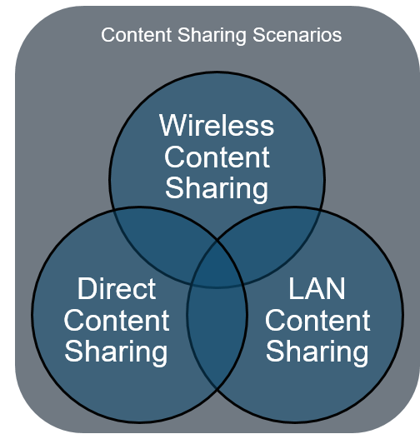
Earlier Content Sharing Solutions provides a single user to share content at a time.

Slide 8
Direct cable connection to the endpoint – limited by hardware inputs, physical cable required along with proprietary software.
AirPlay – proprietary end-user protocol only supported by Apple products
Miracast – Requires WiFi direct, supported on Windows 8.1 & up, supported on some Android devices

Slide 9
Present Day Solutions
Content can be shared in multiple ways.
Wi-Fi, LAN, Bluetooth are the different interfaces used.
Commercially available devices use Miracast and AirPlay to share content over the Wi-Fi Interface.

Slide 10
Why Security?
Content sharing over a network has become critical for effective business communication/collaboration.
Need for security arise because of the nature of the information being shared.

Slide 11
Miracast Vs AirPlay
Miracast is a peer-to-peer Wifi Direct standard roughly called as HDMI over Wi-Fi.
The connection is created via Wi-Fi Protected Setup for authentication and is secured with WPA2.
Legacy AirPlay connection initially utilizes Bluetooth for discovery and then shares the content over the Wi-Fi network.
Newer AirPlay supported devices use peer-to-peer communication and doesn’t require the both end points to be connected to the same Wi-Fi network.

Slide 13
Present Day Solution

Slide 14
Wired (HDMI) presentation
Presentation using the Thick Client (Windows and Mac PCs only)
Wireless presentation using Apple AirPlay
Wireless presentation using Miracast

Slide 17
Attack Surface Identification
Network Interface
Bluetooth
Wi-Fi ( Includes AirPlay and Miracast)
Thick Clients

Slide 18
Wi-Fi
Miracast/AirPlay uses the Wi-Fi Interface.
The 4-way Handshake and the Peer Key Handshake involved are vulnerable to Key Reinstallation Attacks.
Fix: The Patches for the Key Reinstallation attack are applied on the device.

Slide 19
Miracast
To connect to the device via Miracast a PIN value will be displayed on the screen and is to be entered from Miracast enabled device
The PIN length is 4 characters and is easily brute-forced.
Fix: The PIN used for connecting to the device is changed which is now difficult to brute-force and is randomly rotated.

Slide 20
Man In the Middle
Any random user within the same network can connect to the device and share the content within a meeting by sniffing the network.
The PIN needed for connecting to the device is transmitted over clear text.
The length of the PIN is 4 characters and can be brute-forced.

Slide 23
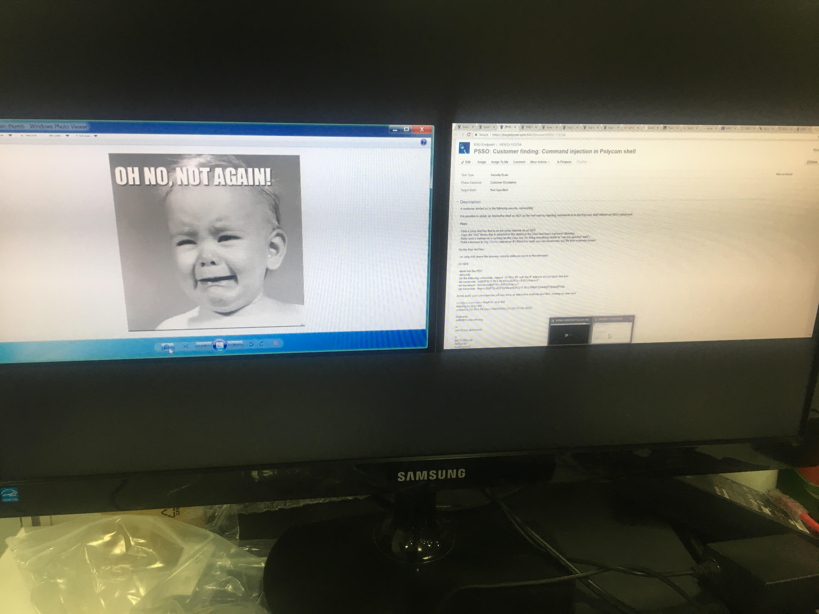
By active sniffing, once the PIN value is found any random user can share content in a meeting.

Slide 24
Mitigation Applied
The communication channel of transferring the PIN is now encrypted.
The length of the PIN is now increased.

Slide 25
Denial of Service
The device has port 5060 open which is for SIP communications.
Sending a series of packets on to the device over the SIP port resulted in Denial of Service and the streaming has been terminated.
Fix: Restricted the number of active sessions and implemented time based clean-up.

Slide 26
Future Work
Need for cloud based security when the annotations resulted from collaboration are stored on the cloud directly.
Security Practices for an enterprise integrated cloud hosted service based products.

Slide 27
Thank You
Subramanyam Irukuvajhula
Kevin Cawlfield
Jeffrey Radice
Sudhir Datla

Slide 28
Questions?
Contact: pratapchandraallena@gmail.com

Slide 29
Thank You

