Slide 1
Sandbox detection: leak, abuse, test
Zoltan Balazs, MRG-Effitas
In cooperation with CrySyS lab, Budapest
We need to go faster than hyper speed. Jump straight to ludicris speed

Slide 2
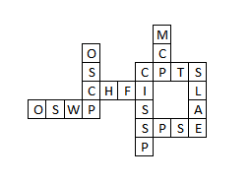
root@kali:~# whoami
Zoltan Balazs
I’m NOT a CEH
Creator of the Zombie Browser Toolkit
https://github.com/Z6543/ZombieBrowserPack
Creator of the HWFW Bypass tool
Idea later(?) implemented by nation state attackers in Duqu 2.0
https://github.com/MRGEffitas/hwfwbypass
Invented the idea of encrypted exploit delivery via Diffie-Hellman key exchange, to bypass exploit detection appliances
Recently implemented by Angler and Nuclear exploit kit developers

Slide 3
root@kali:~# whoami

Slide 4
How may I help you?
Are you analyzing malware and don’t know why it is not running on your sandbox?
Are you writing a malware during pentest?
Are you developing a new malware analysis sandbox?
Are you testing malware analysis sandboxes, because you want to buy one?
Are you bored and just want to watch a fun presentation?

Slide 5
Current malware analysis
Static automated – malware is not started
Easy to bypass
Dynamic automated – malware is started
This presentation is about this type of analysis
Manual
Hard to keep up with daily 400 000 new samples
Analysis can take days, even weeks

Slide 6
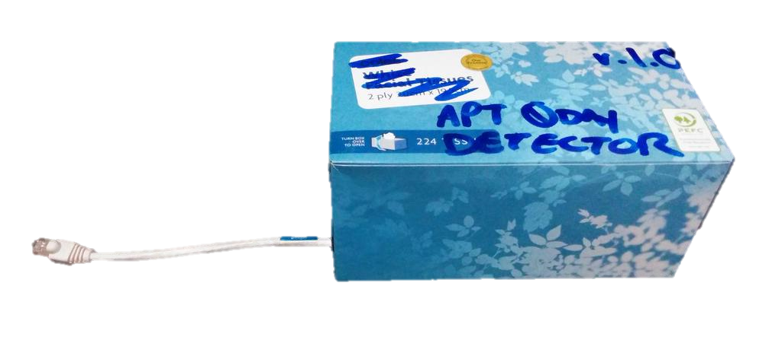
This is the sandbox I want to talk about
Malware analysis sandbox
Breach detection system
A(dvanced) P(ersistent) T(hreats) detector
Malware → ????? → alert/report
@norsec0de

Slide 7
What is my problem with these super cool sandboxes?
The problem is sometimes the
marketing department
price
real value
There are exceptions

Slide 8
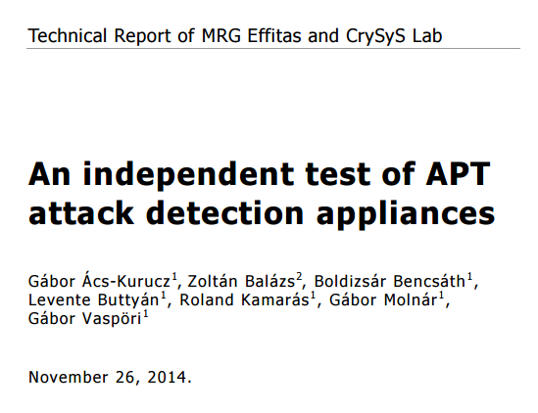
New anti APT tools are no silver bullets
http://bit.ly/1zZJkth

Slide 9
How much $ £ ¥ € does it costs?
10 000 USD - 350 000 USD
+ yearly maintenance up to 100 000 USD
You can buy this “company car” for the same price

Slide 10
Malware analysis sandbox – past and present
Malware analysis sandboxes were used by malware analysts in the past
Nowadays these sandboxes are sold to companies, who lack
Resources
Skills
People
Sold as magic boxes to detect APT malware on the network

Slide 11
Why attackers pentesters evade dynamic analysis via hiding in the shadows?
Long engagement
The malware test doesn’t get busted on day one
Code reuse in new engagements
You don’t have to reinvent the wheel every time for a new project
Detect the sandbox, and change malware behaviour if sandbox detected

Slide 12
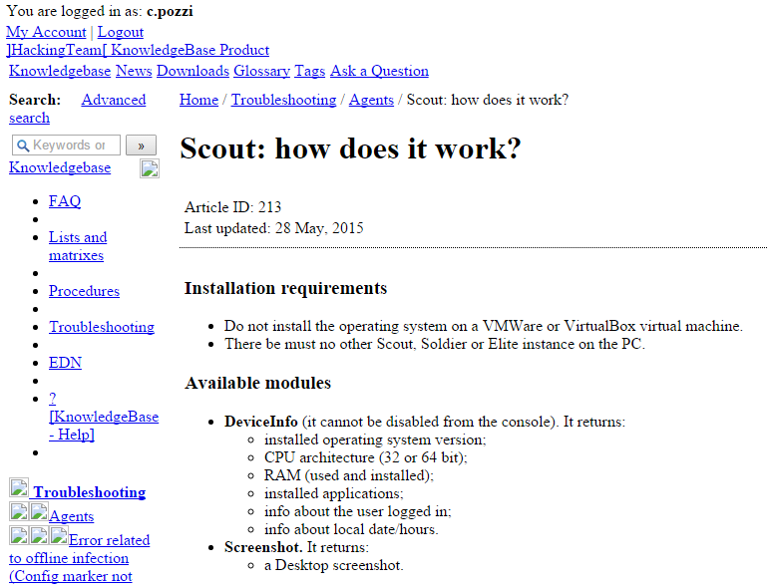

Slide 13
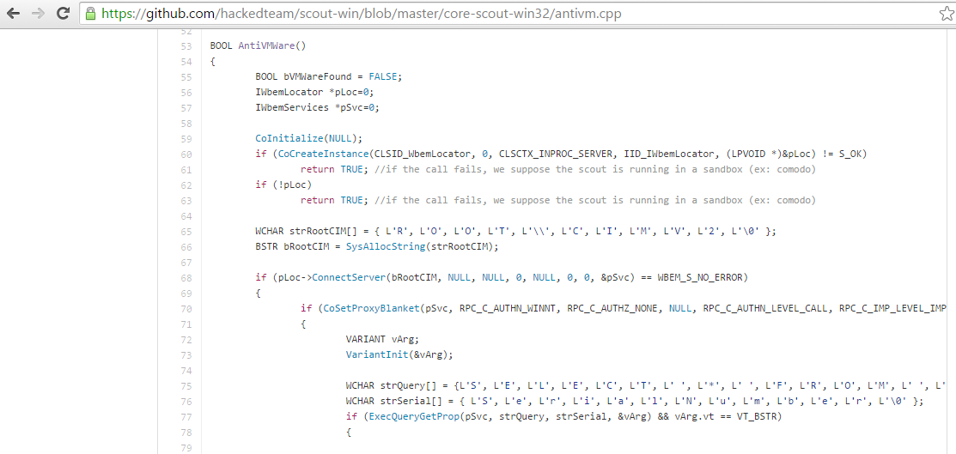
How Hacking Team malware evades detection when #YourBoySerge is not around
VMWare: SELECT SerialNumber FROM Win32_Bios
VirtualBox: Select DeviceID from Win32_PnPEntity
Virtualbox detection technique defeated by Tsugumi from VBoxHardenedLoader

Slide 14
What’s wrong with the current sandbox detection techniques?
Too much focus on virtualization
More and more legitimate targets in virtualized environments
Methods already known and flagged as malicious
VmWare IO ports
Methods already known, defeated and flagged
ProductID

Slide 15
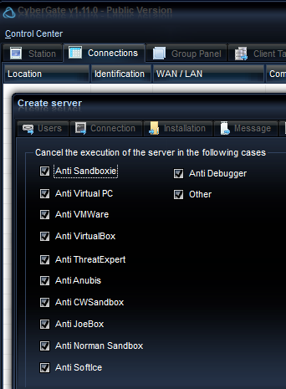
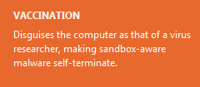
Workstation disguised as a VM

Slide 16
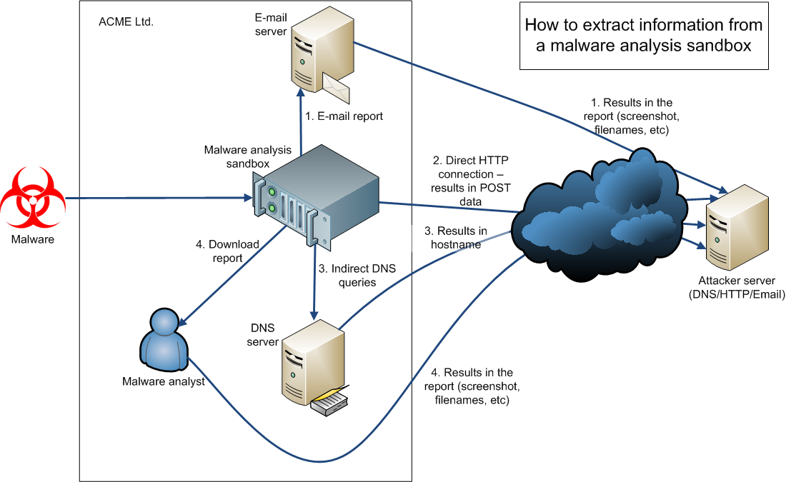

Slide 17
Demo

Slide 18
How to interpret results
Both “sandbox detection effectiveness” and “probability of busted” is measured
Good sandbox detection effectiveness,
easily flagged as malicious
Normal effectiveness, possible flagged
Hard to get flagged as malicious
not effective

Slide 19
Screen resolution
Pro tip
Can be used in exploit kits, before exploit
How many people browse the web with 800*600, or even 1024*768?
Are these people your target?
JavaScript
screen.width, screen.height
works in almost all browser, except Tor browser

Slide 20
Screen resolution
43%: 1024x768 – this is a problem
36%: 800x600 – this is an even bigger problem
640x480 – this is just LOL
1024x697
1280x800
1280x960
1680x1050
1916x1066

Slide 21
Installed software
Python 2.5.1
Tracer
PHP 5.3.8
Python winappdbg 1 4
Debugging Tools for Windows x86
Python winappdbg 1 4
Strawberry Perl
VMware Tools
VEware Tools

Slide 22
Running processes on sandboxes
C:\SandCastle\tools\
FakeServer.exe
FakeHTTPServer\FakeHTTPServer.exe
BehaviorDumper.exe
C:\Python27\python.exe
C:\tsl\RaptorClient.exe
C:\mapp_start_folder\snowball.exe > the sample renamed
C:\tools\dumper.exe
C:\VxStream\StaticStreamMgr.exe

Slide 23
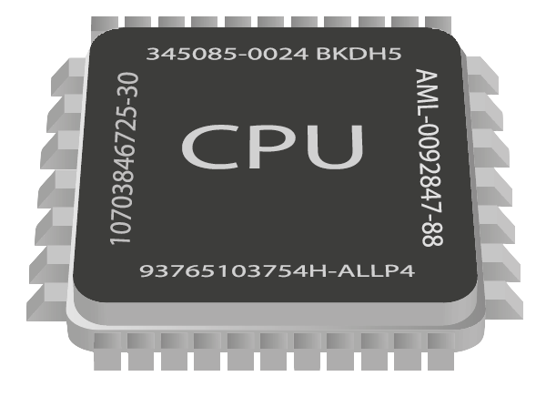
CPU type
AMD Opteron tm Processor 3365 – server
AMD Phenom tm 9550 Quad Core Processor – server
Intel Pentium III Xeon processor – server
Intel R Xeon R CPU E5 2620 0 2 00GHz - server
Intel Pentium Pro processor - ???
Intel Pentium II processor - ???
Intel R Atom TM CPU D525 1 80GHz – desktop
Intel R Core TM 2 Duo CPU T7700 2 40GHz – desktop

Slide 24
CPU 2
Most of the time:
Number of Cores 1
Rarely seen in sandboxes:
Number of Cores 2
Number of Cores 4 (Sandbox in Ukraine)

Slide 25
Computer system – which one can be your real target (e.g. CEO)
Bochs
VirtualBox
VMware Virtual Platform
KVM
X7SPT DF – Supermicro Server Platform
MYTUAL MYVTUAL Platform
OptiPlex 990 – Dell desktop
4287A72 – Thinkpad
P5Q SE – Asus desktop
68% Virtualized, 18% desktop, 14% server

Slide 26
Mouse
80% no mouse movement
20% mouse moved
X:0 Y:0
X:400 Y:300
X:600 Y:600

Slide 27
Memory size
133 730 304
133 734 400
267 894 784
267 952 128
536 330 240
536 403 968
804 765 696
804 818 944
1 073 201 152
1 073 274 880
1 073 328 128
3 219 877 888
4 293 337 088
4 294 500 352

Slide 28
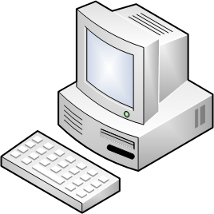
Machine name
Antony PC
C2F3F0B206C14E9
CWS01_23
David PC
GOAT WXPSP2B
GT FDCCD9A7405D
HOME
HOME OFF D5F0AC
Klone PC
Machine name as a white-list can be powerful
PSPUBWS PC
PUBLIC EA8367E7
RON AC13BF686B1
ROOT D
SANDBOXA
TESPC0
test PC
USER201
USERDOMAIN
vwinxp maltest
WILBERT SC1317

Slide 29
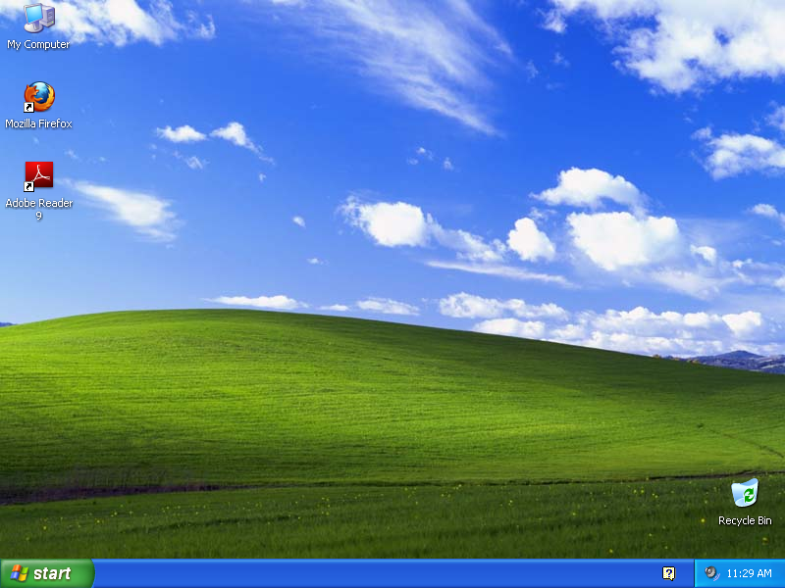

Slide 30
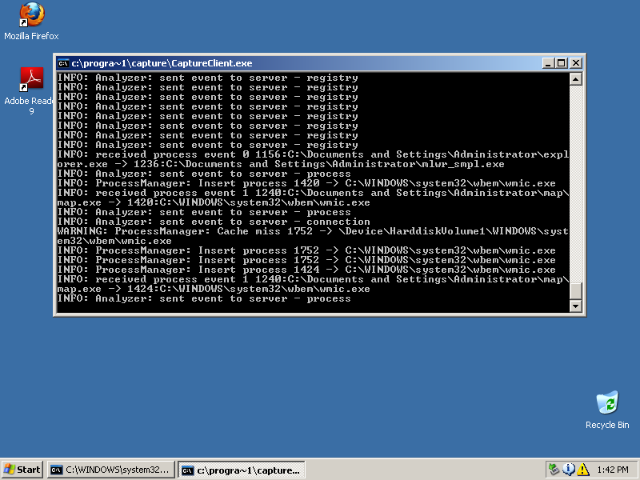

Slide 31
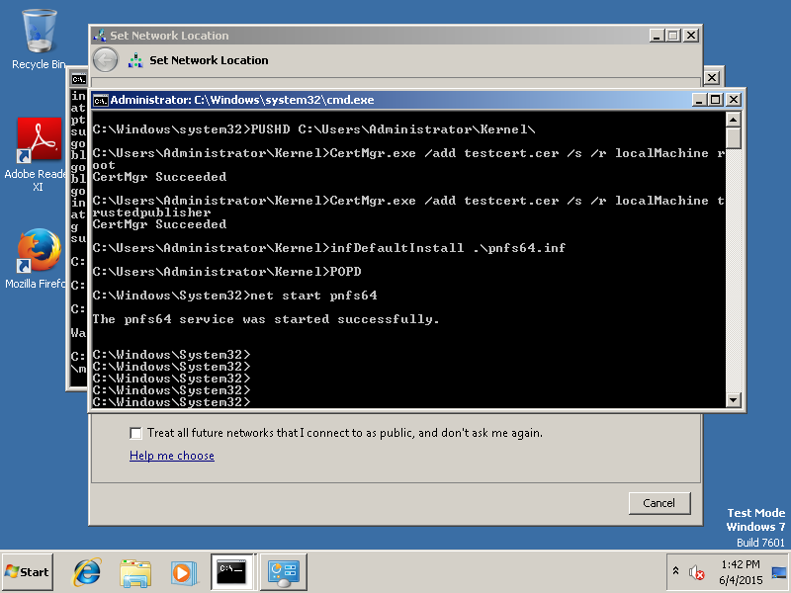

Slide 32
Real “user” desktop, busy working
Screenshots from torrent Hacked Team c.pozzi\screenshots

Slide 33
USB Flash Drive
Usually:
no flash drive
Rarely seen:
128MB USB2 0FlashDrive USB Device
IPMI Virtual CDROM USB Device
Kingston DataTraveler 2 0 USB Device

Slide 34
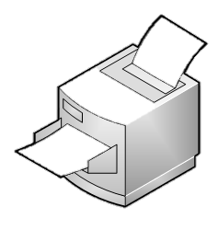
Printer
The only printers in sandboxes:
Default Windows printers
Adobe
Office (Sendnote)

Slide 35
Recently modified/created files
Based on the folder you are looking at (Desktop, Documents, Appdata, Temp, …)
it is usually less than 3 on sandboxes
a lot more than 3 on desktops
Slow ☹

Slide 36
Where to implement these sandbox detection methods?
1. Before the malware is dropped, e.g. in Javascript or in shellcode
2. Automated decision, in the malware
Pro – no info leak about C&C
Con – not everything can be implemented here
3. Automated, on the C&C server
Pro – lot more possibilities
Con – C&C server info leaked
4. Manually, info from the C&C server
Pro – powerful e.g. analyze desktop screenshot
Con – expensive
Best approach
Use all four layers, stop execution at first detection

Slide 37
The hard problems – Part 1
Is sleep function simulated?
No (89%)
Sleep for a certain amount of time
Reach timeout limit (5 minutes)
PROFIT
Yes (11%)
Easy to detect
Detect it and quit
PROFIT
Solution:
Continuous sandboxing

Slide 38
The hard problems – Part 2
Network connection
Is there a HTTP connection to the Internet (directly or proxy)?
Yes
Leak some data – e.g. multiple screenshots
Decide on server side
PROFIT
No
If you don’t target airgapped machines, it’s safe to quit
PROFIT
There is one, but it is emulated
Detect it by downloading a known object
Calculate hash
Compare
PROFIT

Slide 39
Lessons learned
Malware writers (penetration testers)
It is incredibly easy to evade static and dynamic analysis
Manual analysis is hard (or impossible) to defeat
But possible with lot of samples and new tricks on the long run!
Sandbox developers
If you are selling your sandbox for $$$, try harder
Dump a real user workstation and keep updated with user behavior
It is hard to do it right, but easy to do it wrong
Blue team/defensive side
Test your sandbox before buying
Customize your sandbox to match your desktops
Don’t trust the marketing/sales department
There are some good sandboxes out there!

Slide 40
The basics
https://github.com/hfiref0x/VMDE
https://github.com/hfiref0x/VBoxHardenedLoader
http://www.kernelmode.info/forum/viewtopic.php?f=11&t=1911
http://blog.michaelboman.org/2014/01/making virtualbox nearly undetectable.html
https://github.com/wmetcalf/buildcuckoo trusty
http://avtracker.info/
http://jbremer.org/vmcloak2/
https://www.youtube.com/watch?v=Ez_Gl5D_BV0
https://github.com/Yara-Rules/rules/blob/master/antidebug.yar
http://www.securitygalore.com/site3/vmd1-advisory

Slide 41
Hack the planet! One computer at a time …
https://github.com/MRGEffitas/Sandbox_tester
zoltan.balazs@mrg-effitas.com
https://hu.linkedin.com/in/zbalazs
Twitter – @zh4ck
www.slideshare.net/bz98
Greetz to @CrySySLab, @SpamAndHex
JumpESPJump.blogspot.com

