Slide 1
Do PDF Tools Conform To The Specification?
Prashant Anantharaman
prashant@prashant.at
https://prashant.at

Slide 2
whoami
Senior Security Researcher at Narf Industries
Resides in Boston, USA; originally from Chennai, India
Ph.D. in CS from Dartmouth College from May 2022 where I worked with Sean Smith and Sergey Bratus
Formal Verification, File Formats, Weird Machines and Parser Exploits
@parsingpunisher

Slide 3
Acknowledgments
My Ph.D. advisors: Sean Smith and Sergey Bratus
Collaborators on this work: Prashanth Mundkur and Natarajan Shankar (SRI International) and Peter Wyatt (PDF Association)
Funding Agency: The DARPA SAFEDOCS project

Slide 4
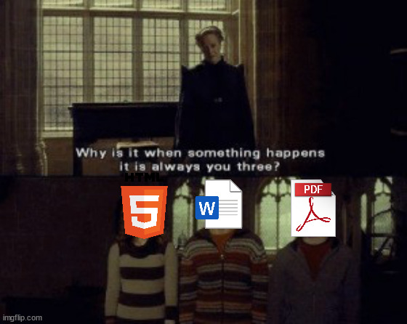
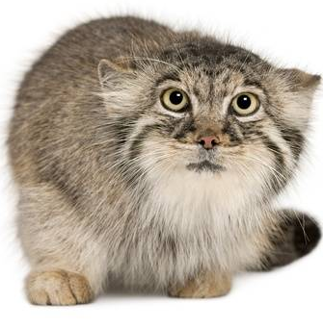
Why PDFs?
Hmmm? Don’t they embed several other formats starting with images and everything?
(a long Russian story…)
Lately we’ve been thinking about PDFs! How do we even write a parser to validate PDFs?
@MyMilkedEek

Slide 5
Do specifications still matter?
Thousands of PDF readers and text extraction tools need to display exactly the same content.
Here is a demo of 3 text extraction tools!

Slide 6
Overview
LangSec Introduction
PDF Format Overview
Our Approach
SPARTA
PDFFixer

Slide 7
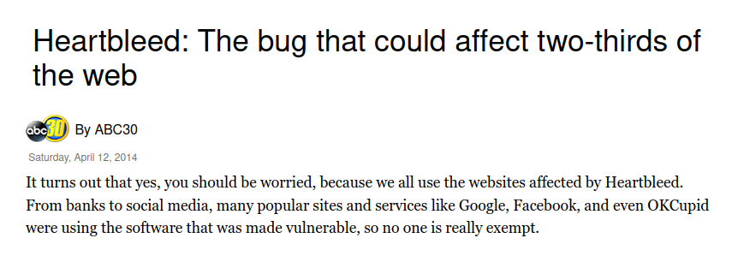
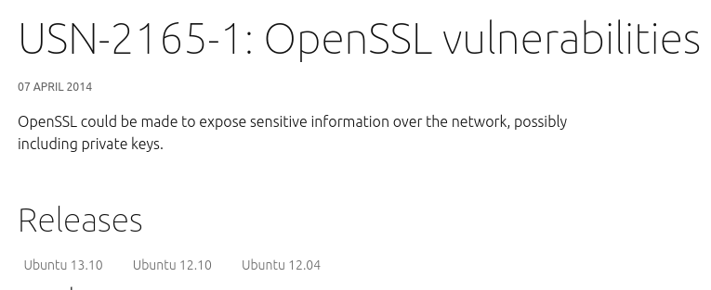
The Heartbleed bug

Slide 8
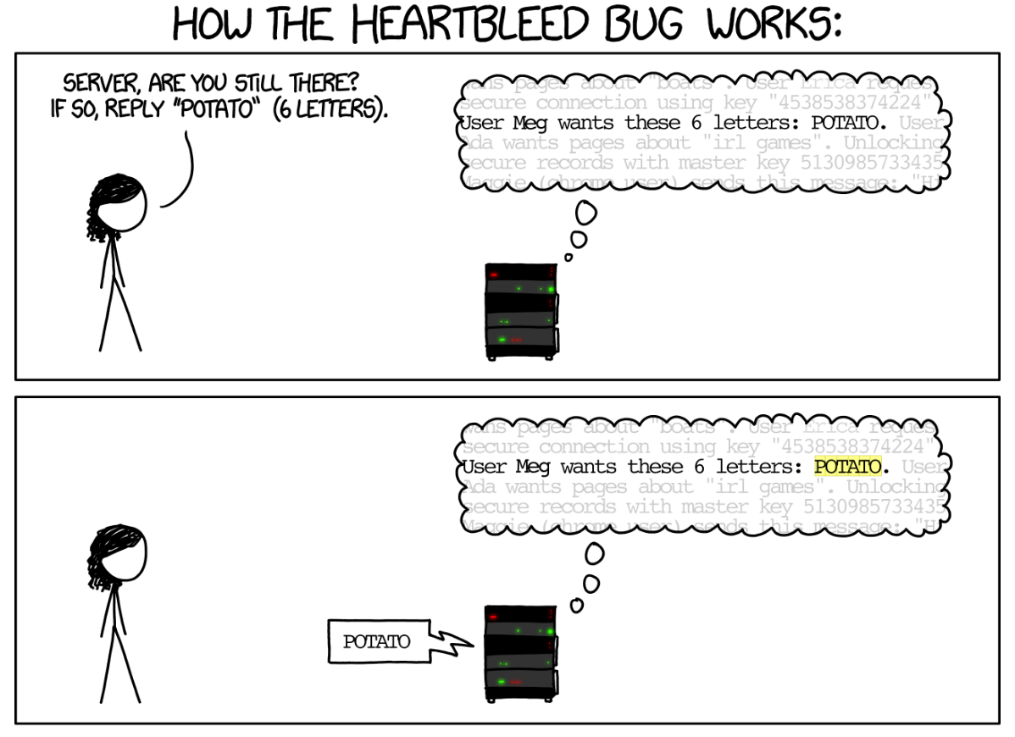
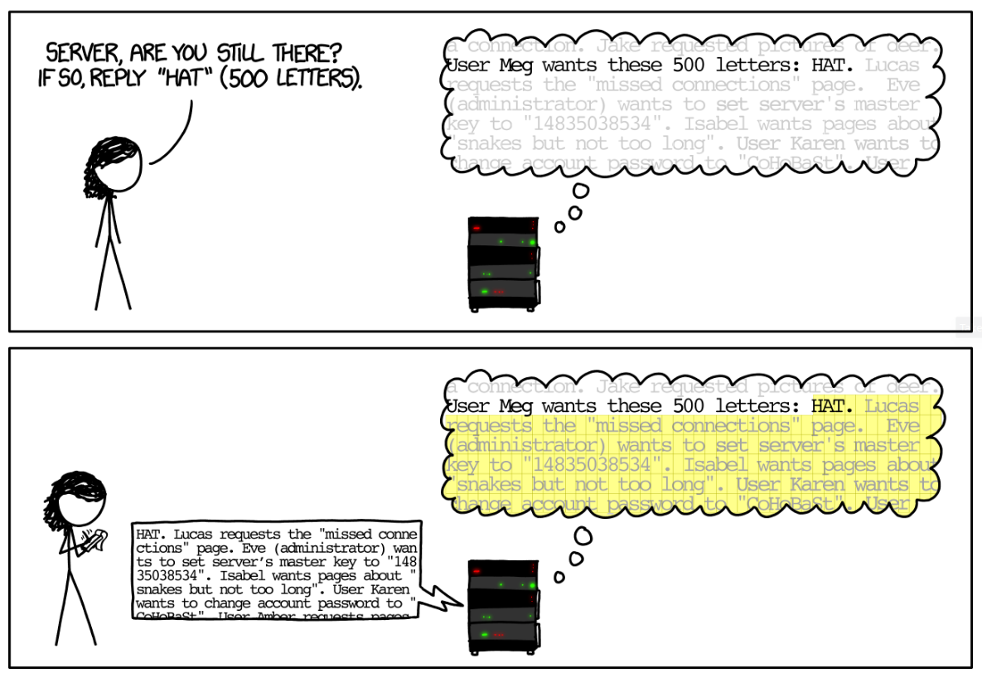
The Heartbleed bug (contd.)
Source: https://xkcd.com/1354/

Slide 9
Pegasus ForcedEntry Exploit
Attackers use PDF files disguised as GIF images
Crafted input that exploits vulnerabilities in the PDF library
Source: https://www.trendmicro.com

Slide 10
Software Systems and Inputs
Possible
inputs
Software
System
Expected
inputs

Slide 11
The Parser
Unstructured
input
Structured, well-typed objects
Validate Input
Transform to
structured format
Parser
“Improper Input Validation” is consistently in the top 5 common weaknesses in software according to MITRE.
Incorrect or insufficient parsers are vulnerabilities that lead to exploits

Slide 12
Parser Differences Lead to Vulnerabilities
Parser differentials: one message leads to two different outputs
X.509/ASN.1 parsers disagree on what should be in a common name (CN) entry with-respect-to null characters.
If CN=www.bank.com[NULL].badguy.com, different parsers interpret this CN differently
www.bank.com\x00.badguy.com
www.bank.com.badguy.com
www.bank.com
“PKI Layer Cake: New Collision Attacks Against the Global X.509 Infrastructure,” Dan Kaminsky, Len Sassaman, Meredith L. Patterson, 2010
Different parsers for the same format must produce the same output.

Slide 13
iOS XML Parser Differential
Three XML parsers in iOS: IOKit, CF, and XPC handle (a) <!---> and (b)<!--> comment delimiters incorrectly.
Used extensively in iOS entitlements---iOS permission systems
Adversaries can forge entitlements where some permissions get interpreted as comments in one parser, whereas another parser grants the permissions.
Checking equivalence of parsers when input language is beyond deterministic context-free is undecidable
Source: https://blog.siguza.net/psychicpaper/

Slide 14
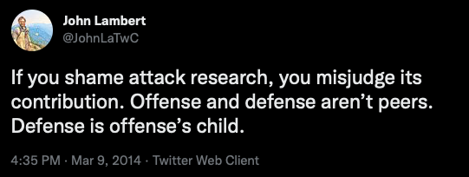
Language-Theoretic Security (LangSec)
Offensive
Security
Defensive
Security
Formal Language
Theory
Langauge-Theoretic Security

Slide 15
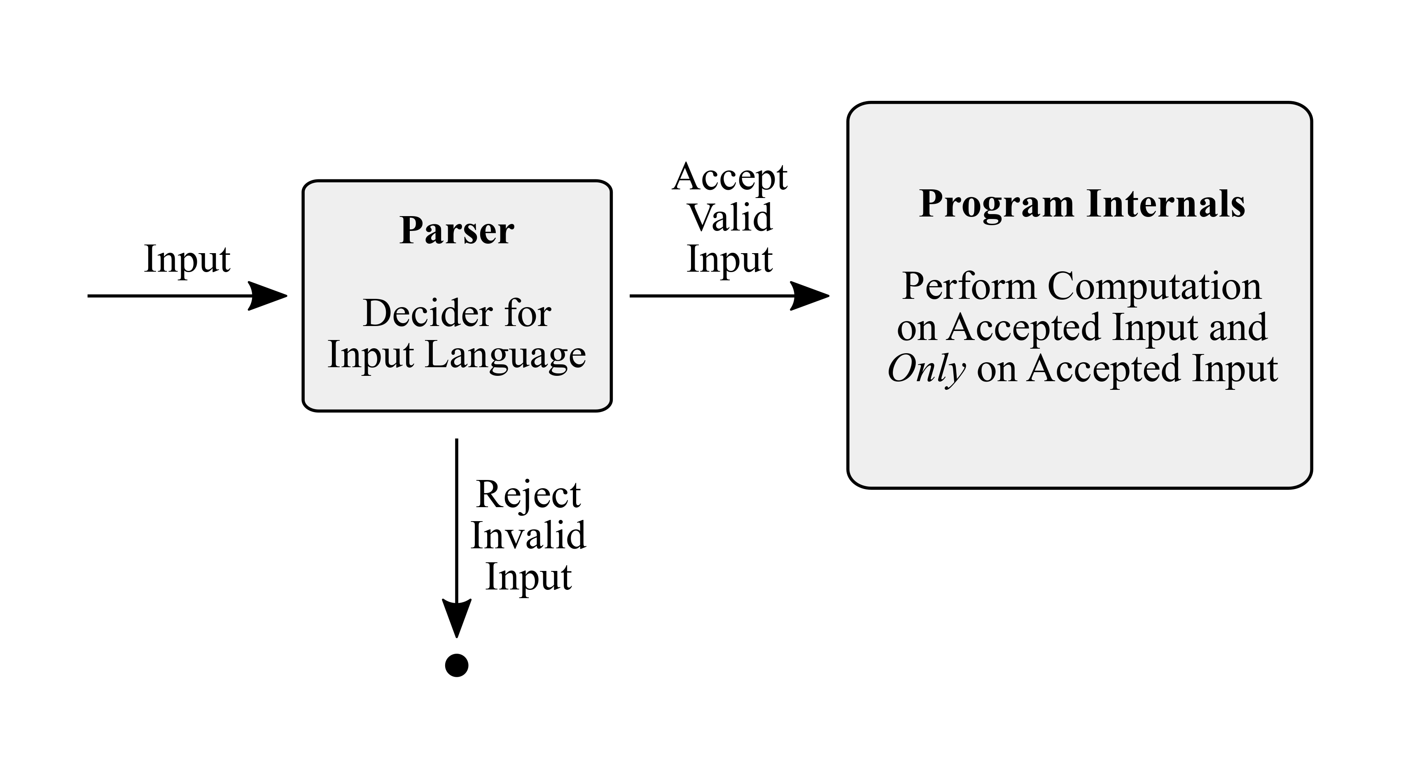
Core LangSec Principles
All input must be recognized by a formal grammar:
fully recognize your input before operating on them
Keep the input language as simple as possible:
Principle of least expressiveness
Separate your parser from code:
Helps audit the parser separately
Ensure program internals only act on fully validated input

Slide 16
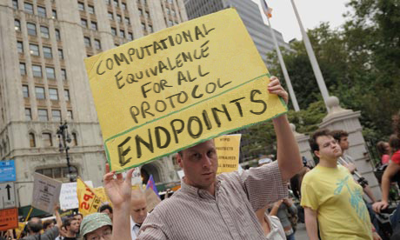
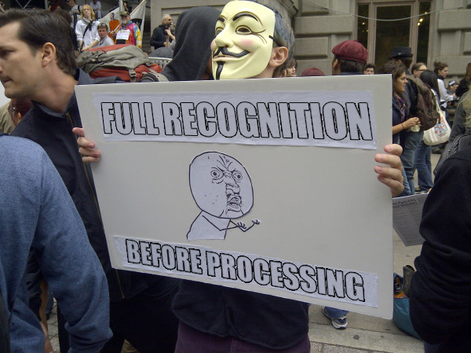
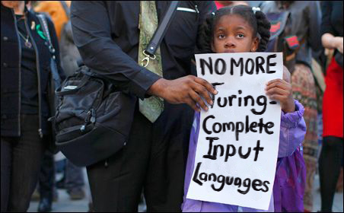
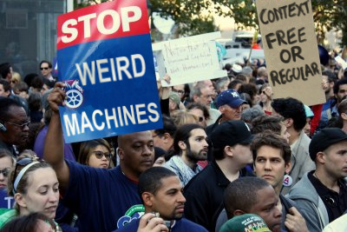
Or...

Slide 17
The LangSec Paradigm
Input
Validation
M
Possible
inputs
Software
System
Expected
inputs
L_{I}
L_{I} and L_{M} must be equivalent

Slide 18
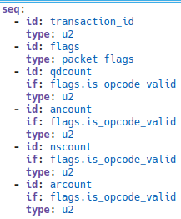
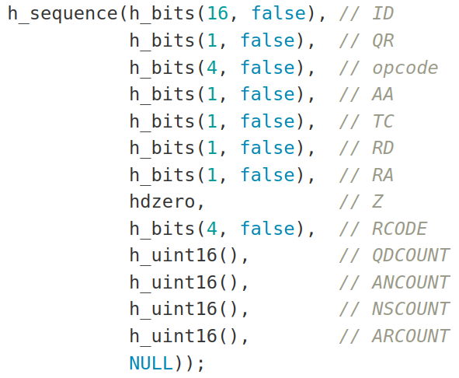
LangSec in Practice
Parser Combinators implement code that looks like a grammar
Hammer (C, C++, Java, and several others), Nom (Rust)
Data Description Languages generate code from a grammar specification
Kaitai (YAML syntax) generates code in various languages
DFDL (XML/XSD syntax) generates C++ and Java code
Nail defines a new syntax and generates code that are bindings to Hammer combinators
kaitaistruct.org: DNS spec
https://gitlab.special-circumstanc.es/hammer/hammer/

Slide 19
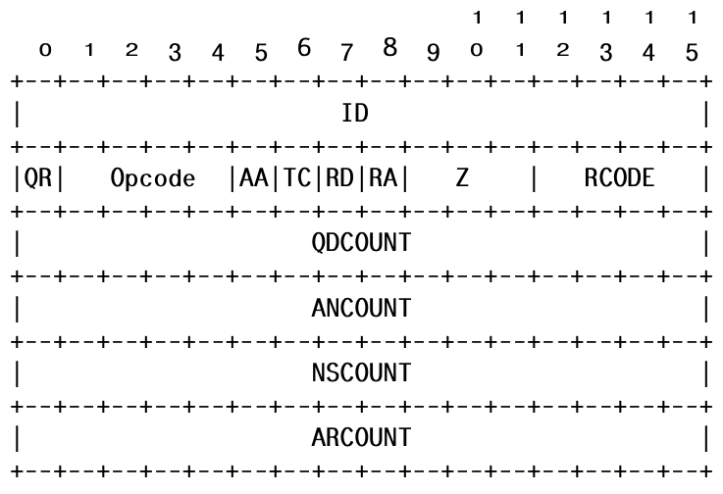
LangSec in Practice (contd.)
DNS format
Hammer
Kaitai
DNS RFC message format
https://gitlab.special-circumstanc.es/hammer/hammer/
kaitaistruct.org: DNS spec

Slide 20
Overview
LangSec Introduction
PDF Format Overview
Our Approach
SPARTA
PDFFixer

Slide 21
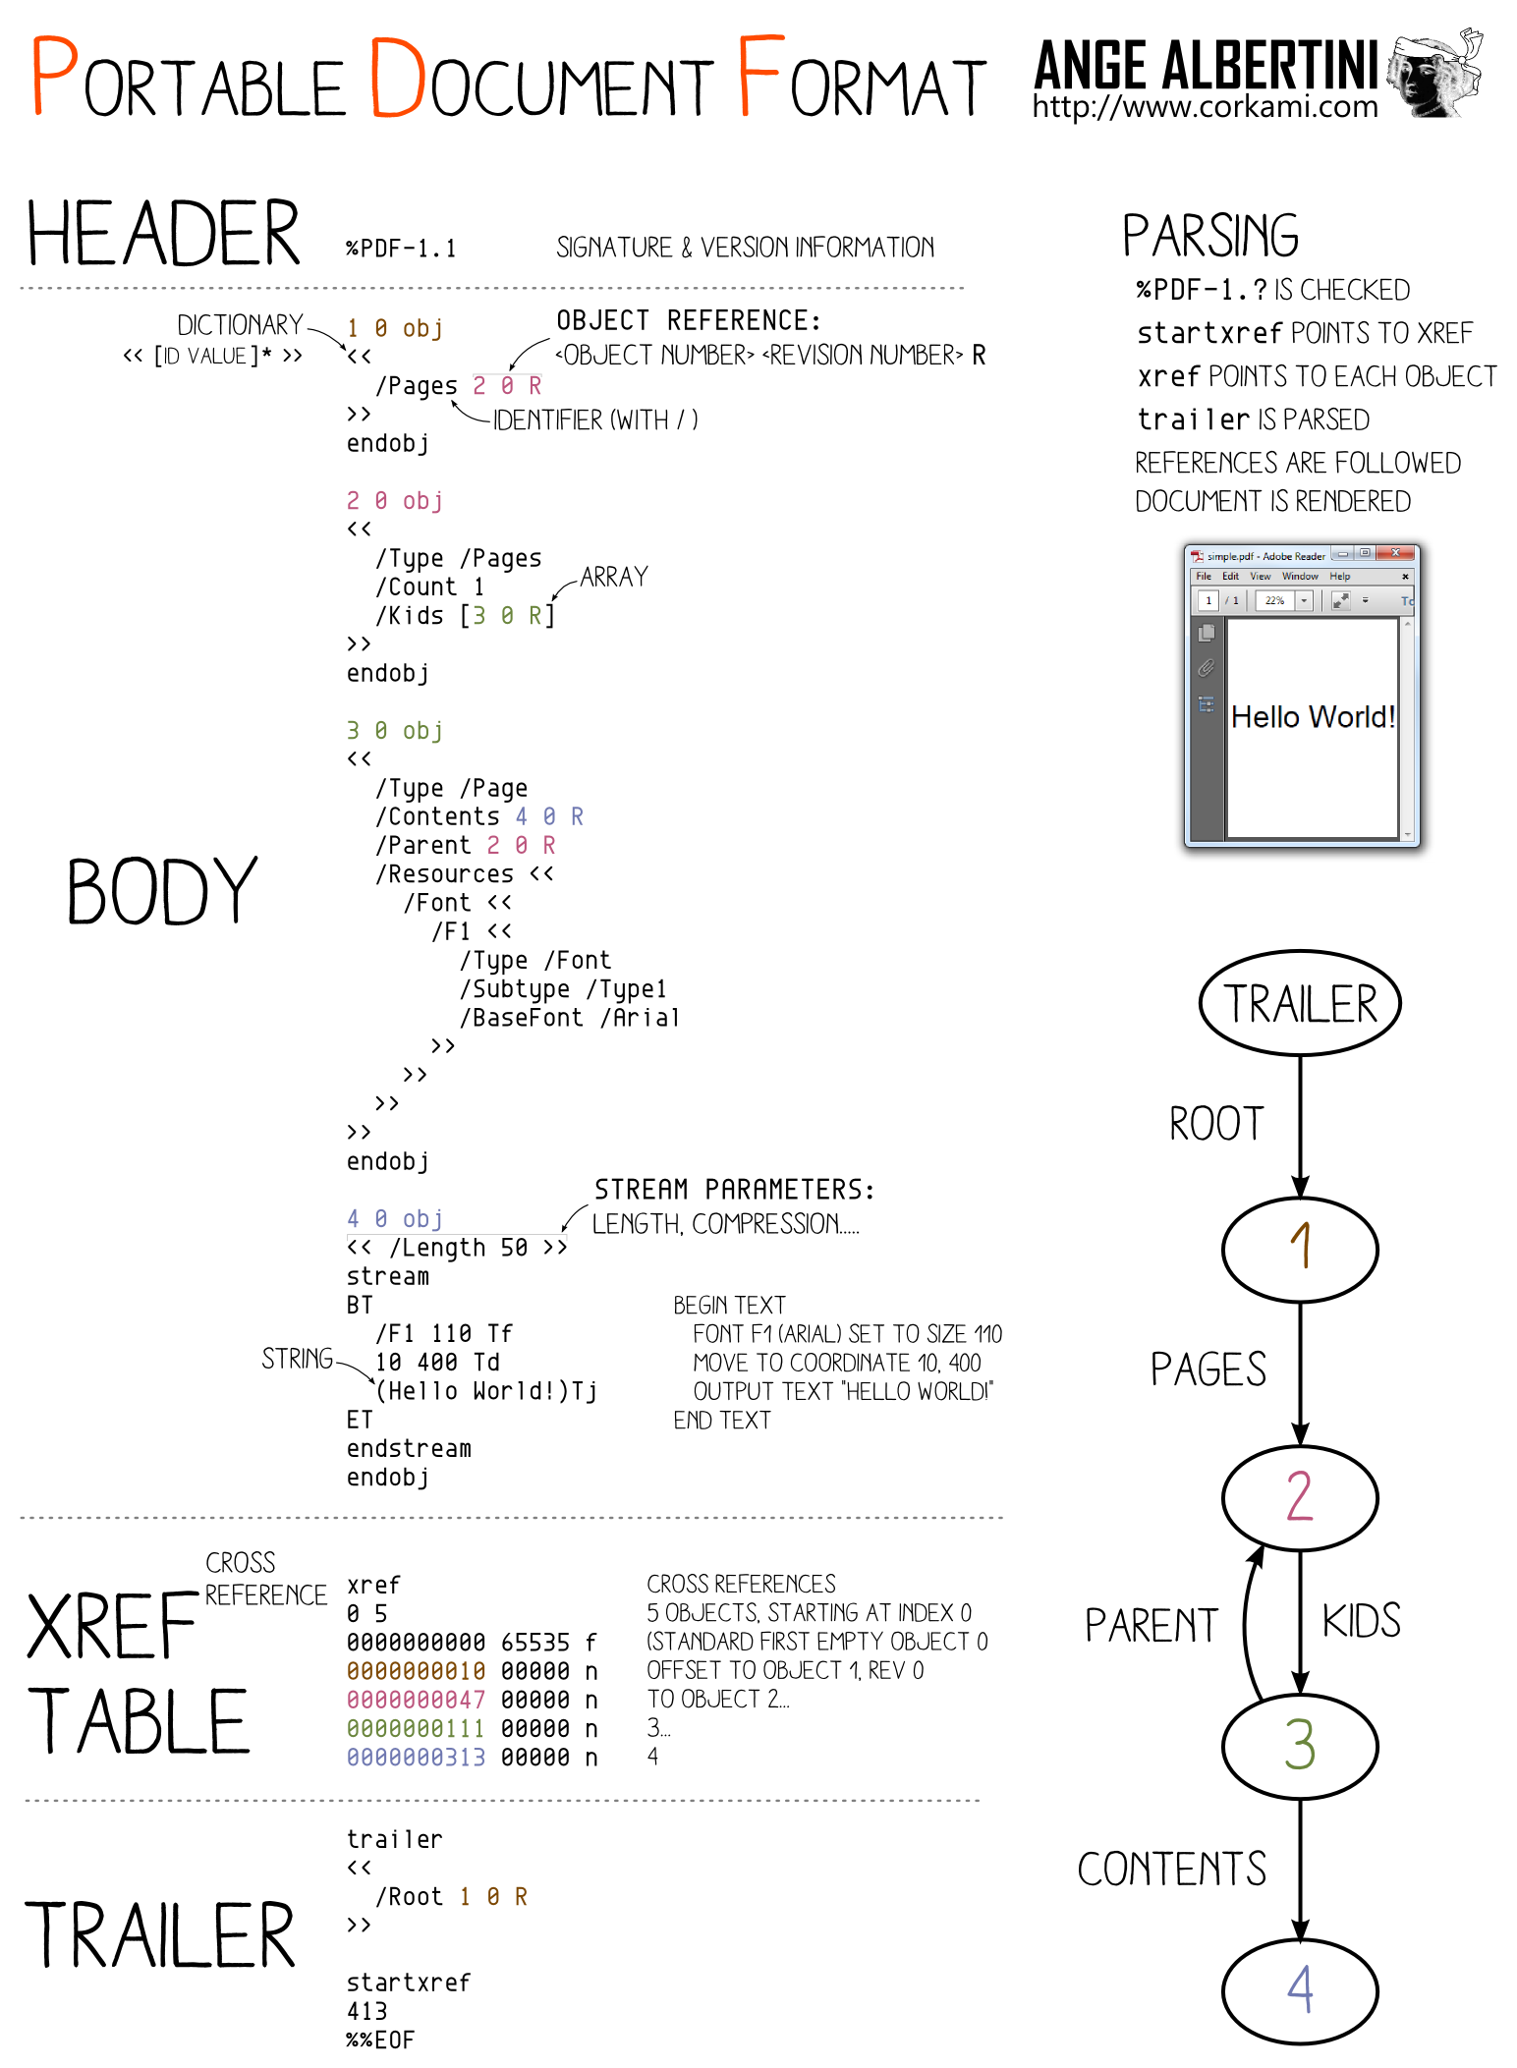
The PDF Format
The PDF 2.0 specification is complex
971 pages of specification
Each object type defined has a purpose:
Dictionaries must contain certain fields
They may also have several optional fields that have type specifications
The Root dictionary (Catalog) may contain 33 keys

Slide 22
Arlington PDF DOM
A TSV-syntax document defining every PDF dictionary and array object
Totally 515 TSV files
3544 rows of data in total
Each row includes 12 columns defining the pre-defined type, possible values, if it is an indirect reference, if it can be inherited, if it is a required field, and Links
Links are userdefined types that correspond to other TSV files in the Arlington model.

Slide 23
Overview
LangSec Introduction
PDF Format Overview
Our Approach
SPARTA
PDFFixer

Slide 24
The Parsley Project
Text Extraction
Extracted
Text
Syntax Checker
Type Checker
Original
PDF
File
PDF Transformer
Transformed
PDF File
The Parsley Rust System

Slide 25
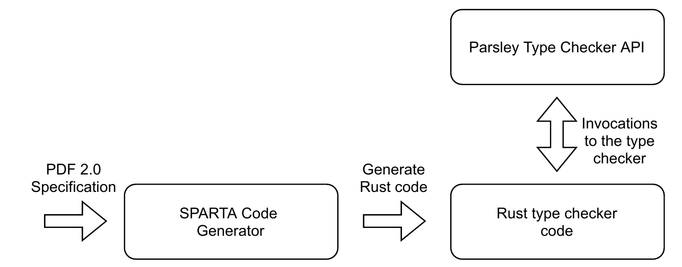
SPARTA and the Parsley Type Checker
SPARTA generates Rust code that calls the Parsley Rust API
Type check dictionary and array contents
Check for mandatory fields
For each field present in a PDF object, apply the correct type
Our type checker does a breadth-first search starting with the Catalog or Info dictionary
Machine-generating parsers/type checkers from a single machine-readable specification reduces differentials

Slide 26
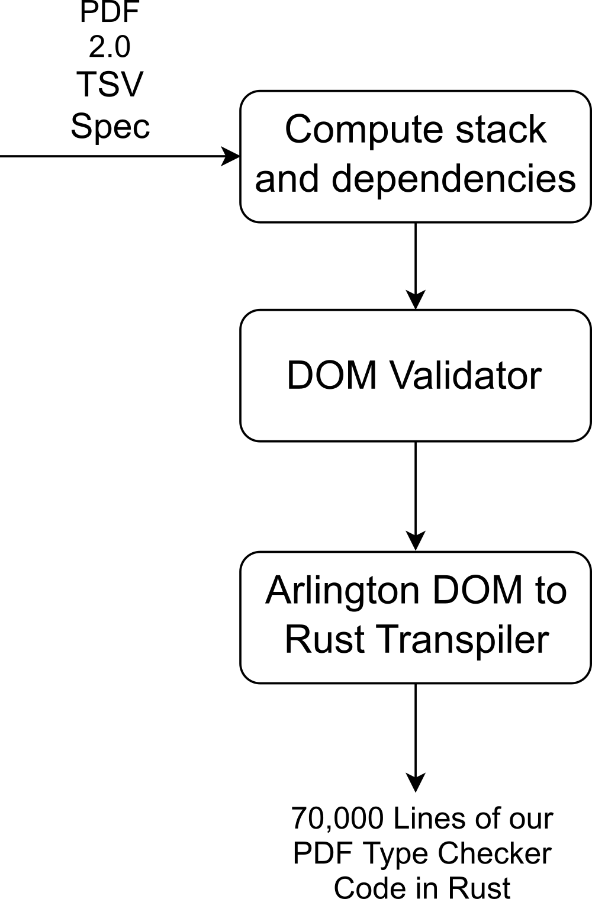
SPARTA
We generated Parsley Type Checker code from the Arlington PDF DOM
The DOM Validator found two errors in the PDF specification
SPARTA generates error-free and warning-free Rust code that type check all complex data structures in the PDF specification

Slide 27
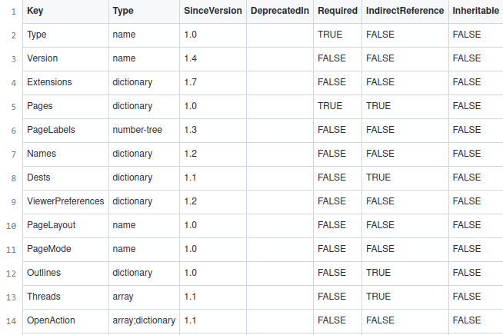
SPARTA Generator
Arlington DOM Syntax
Parsley Type Checker API
let entry_version = DictEntry {
key: Vec::from("Version"),
chk: mk_version_possible_typchk(tctx),
opt: DictKeySpec::Optional,
};
let entry_extensions = DictEntry {
key: Vec::from("Extensions"),
chk: extensions_type(tctx, false),
opt: DictKeySpec::Optional,
};
let entry_pages = DictEntry {
key: Vec::from("Pages"),
chk: pagetreenoderoot_type(tctx, true),
opt: DictKeySpec::Required,
};

Slide 28
SPARTA + Arlington PDF Model Demo

Slide 29
Finding Parser Differentials
PDF files log the tools used to create the PDF file
We logged various type checker violations by the PDF creation tools
*Date

Slide 30
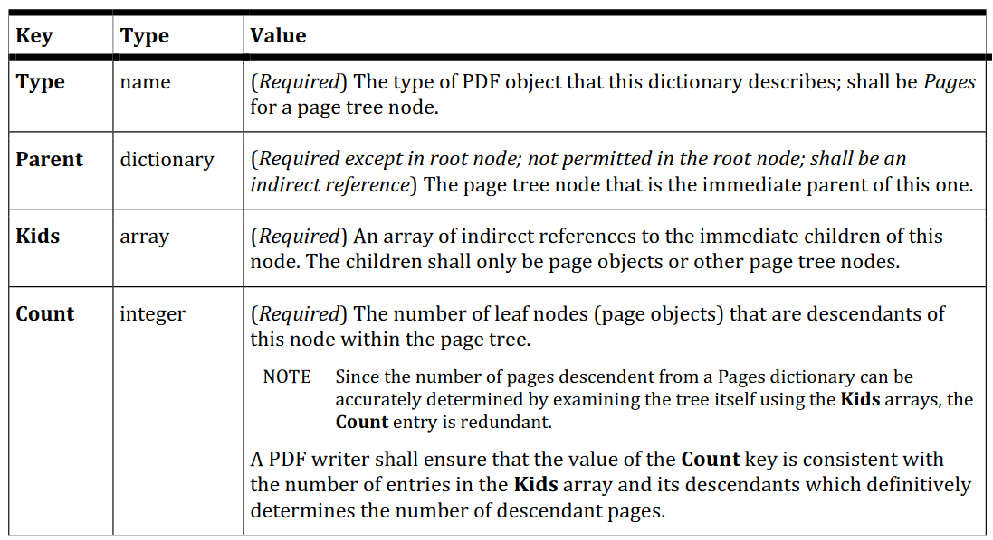
Page Tree Nodes are interesting

Slide 31
Type Checker Demo

Slide 32
Evaluation on the arXiv dataset
We collected PDFs from three months (January to March 2022) of arXiv data
This accounted for over 40,000 PDF files amounting to over 100 GiB
Latex tools seem to get font dictionaries wrong very often

Slide 33
Why do we need a transformation tool?
PDFs contain numerous type errors
These type mismatches can lead to parser differentials, text extraction differentials, or rendering differentials

Slide 34
PDFFixer Overview
Parsley IR: An intermediate representation to store the syntax of PDF objects
Parsley Reducer: Applies a set of transformations to the IR

Slide 35
An example

Slide 36
PDFFixer applications
Normalize PDFs: Several PDFs in the wild contain bugs that lead to differentials. We must normalize PDFs to bring them closer to the standard
Redacting data: PDFs often contain sensitive metadata
Creation tools used, author names, operating system versions
Adversarial file generation: Generating malformed files to test PDF readers for resilience
We found a denial-of-service attack in versions of Mutool prior to 2020.

Slide 37
Machine Readable Specs may not be perfect either

Slide 38
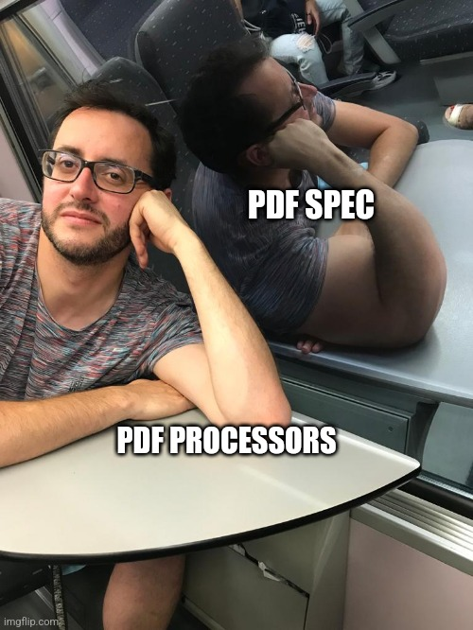
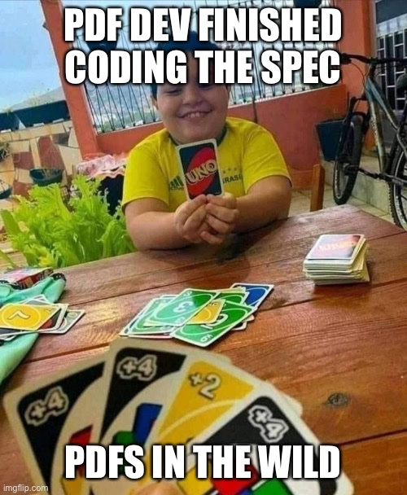
But...
From @_tallison and @MyMilkedEek

Slide 39
Prashant Anantharaman
prashant@prashant.at
https://prashant.at
Thank you
Talk to me about:
Weird Machines,
Industrial/Home IoT Security, and
File Formats.
Questions?

