Slide 1
Elevating the TrustZone to Achieve a Powerful Android Kernel Exploit
Tamir Zahavi-Brunner

Slide 2
About me
Tamir Zahavi-Brunner (Twitter: @tamir_zb)
Previously:
Security research at IDF
Android vulnerability research at Zimperium
Software engineer at NextSilicon
Notes:
This research was done in my free time, mostly in the month between Zimperium and NextSilicon

Slide 3
What will I talk about
A brief overview over Qualcomm’s TrustZone
Going deeper into how Qualcomm’s TrustZone communication protocol works
The vulnerability I found (CVE-2021-1961) in the implementation of this communication protocol
How I exploited this vulnerability to achieve an extremely reliable kernel compromise (unfortunately I won’t have enough time to go into complete details)
Takeaways from this research

Slide 4
The Qualcomm TrustZone

Slide 5
The Android TrustZone
A big and important aspect in Android’s security. A whole separate OS running on every Android device, alongside Android.
Usually used in cryptography operations, like keys for encrypting/decrypting data (e.g. DRM). Makes sure the keys won’t be exposed even in case of a full kernel compromise.
More privileged than the kernel (perhaps the most privileged component in Android)
Unlike Android which is mostly open source, the TrustZone is completely closed source*
*Some chipsets have open source TrustZone, but they are new/rare
Notes:
Closed source is also a motivation

Slide 6
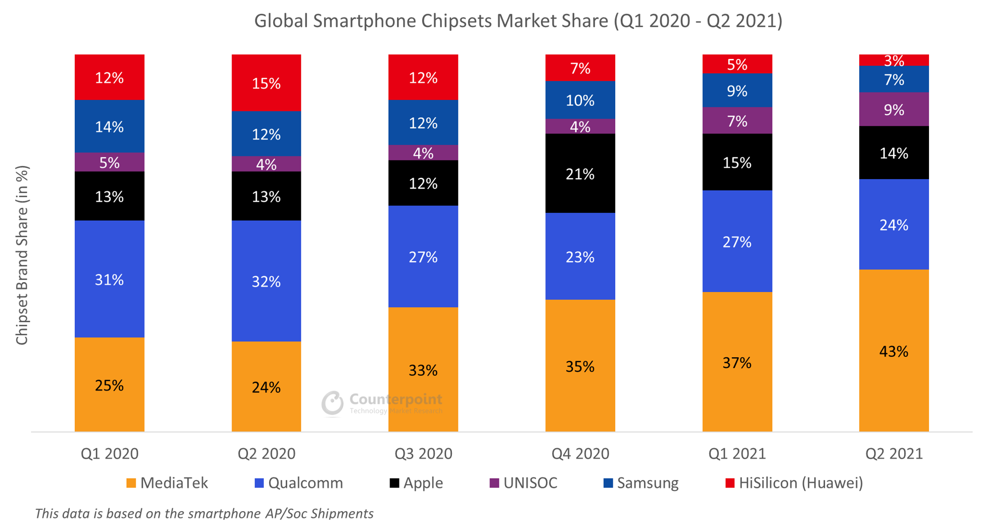
The Qualcomm TrustZone
Each chipset (Qualcomm, Samsung/Exynos, Huawei/HiSilicon, etc) has its own TrustZone implementation
QSEE/QTEE: Qualcomm Secure/Trusted Execution Environment

Slide 7
Motivation: Is Qualcomm’s TrustZone under-researched?
Most thorough research - Gal Beniamini’s set of blog posts. Last one was in 2016.
Since then:
TrustZone apps fuzzing from RECON Montreal 2019 - Used an old QSEE from Nexus 6.
Investigating and Breaking Widevine on QTEE from BlackHat Asia 2021
Maybe more that I missed?
Notes:
The Samsung/Exynos TrustZone is much more researched

Slide 8
The Android TrustZone
Normal World
Secure World
EL0
App
App
App
Trustlet
Trustlet
Trustlet
EL1
Kernel
Secure Kernel
EL2
Hypervisor
Secure Hypervisor
EL3
Secure Monitor

Slide 9
The Qualcomm TrustZone: Relevant parts
Normal World
Secure World
EL0
(user mode)
Android user mode
Trustlet
/dev/qseecom
Linux kernel
EL1
(kernel)
QSEECom
QSEE kernel
QSEECom: The Linux kernel part in charge of communication with QSEE
Notes:
Focus on the terminology

Slide 10
Technical Details

Slide 11
Preface
This is not a full root vulnerability
In order to exploit it you need access to /dev/qseecom, which is only accessible by some privileged Android services
It only works on Qualcomm devices
BUT:
My main idea is not to just achieve “one more root exploit”, but rather discuss new and interesting exploitation techniques
It is still a very powerful kernel exploit that works on all Qualcomm devices/versions

Slide 12
QSEE Memory Access Model
Unlike the Linux kernel which operates in virtual addresses, QSEE operates in physical addresses*
Linux kernel can’t access QSEE’s region of physical addresses
The QSEE kernel has full access to the Linux kernel memory
Trustlets memory accesses are limited by the QSEE kernel, so normally can’t access the Linux kernel
*Actually they are virtual addresses which mirror the physical addresses

Slide 13
QSEE Memory Access Model
Physical address space:
Normal Memory
Linux kernel
QSEE kernel
User mode process
Secure Memory
Trustlet
Notes:
But memory needs to be shared

Slide 14
Normal World <-> Secure World
The vulnerability is in QSEECom, so I’ll start with the background: How communication works between the other components
Trustlet
Linux kernel
QSEE kernel
Notes:
Going gradually into deeper technical details

Slide 15
Normal World <-> Secure World: Simple version
IPC/RPC: Send input, receive output
The Linux kernel calls the Secure World through something called SMC (Secure Monitor Call, kind of like a system call)
In this SMC, it provides two physical address pointers to buffers in the Normal World memory, one for input and one for output (alongside sizes of course)
The QSEE kernel gives the trustlet access to these buffers

Slide 16
Normal World <-> Secure World: Simple version
Linux kernel
QSEE kernel
Normal Memory
Input

Slide 17
Normal World <-> Secure World: Simple version
Trustlet
Linux kernel
QSEE kernel
Normal Memory
Input

Slide 18
Normal World <-> Secure World: Simple version
Trustlet
Linux kernel
Normal Memory
Input
Output

Slide 19
Normal World <-> Secure World: Simple version
Trustlet
Linux kernel
Normal Memory
Input
Output

Slide 20
Normal World <-> Secure World: More complex
The input buffer can have pointers to other buffers in Normal World memory
The Linux kernel can provide up to 4 whitelist entries, used to tell the QSEE kernel which other areas of Normal World memory it can whitelist for the trustlet

Slide 21
Normal World <-> Secure World: Whitelist entries
Linux kernel
QSEE kernel
Normal Memory
Input
Input/Output

Slide 22
Normal World <-> Secure World: Whitelist entries
Whitelist entry
Linux kernel
QSEE kernel
Normal Memory
Input
0xdeadbeef
Input/Output

Slide 23
Normal World <-> Secure World: Whitelist entries
11 22 33 44 ef be ad de 00 00 00 00 fe fe fe fe
00 00 00 00 01 00 00 00 55 66 77 88 99 aa bb cc
Input buffer
0xdeadbeef
Whitelist entry
offset = 4
size = 0x10000
Notes:
The offset is into the buffer

Slide 24
Normal World <-> Secure World: Whitelist entries
Trustlet
Linux kernel
QSEE kernel
Normal Memory
Input
Input/Output

Slide 25
Normal World <-> Secure World: QSEECom side
Now, let’s go into details about the QSEECom side
Android user mode
/dev/qseecom
Linux kernel
QSEECom
Notes:
The user mode process needs to make the kernel do all of this

Slide 26
Normal World <-> Secure World: QSEECom side
QSEECom uses the ION kernel mechanism
ION tl;dr: File descriptors that point to buffers. An ION buffer can be mapped both in user space and in kernel space.
All data from/to QSEE is on ION buffers

Slide 27
Normal World <-> Secure World: QSEECom side
Android user mode
Normal Memory
ION buffer
Input

Slide 28
Normal World <-> Secure World: QSEECom side
Android user mode
ioctl
Linux kernel
QSEECom
Normal Memory
ION buffer
Input
Notes:
And from there it goes to and back from the trustlet like I discussed before

Slide 29
Normal World <-> Secure World: QSEECom with pointers
QSEECom also supports the pointers mechanism
QSEECom allows you to add up to 4 ION fds to each ioctl, which it turns into whitelist entries
It is also in charge of writing the physical addresses into the input buffer (user mode doesn’t know the physical addresses)

Slide 30
Normal World <-> Secure World: QSEECom with pointers
11 22 33 44 00 00 00 00 00 00 00 00 fe fe fe fe
00 00 00 00 01 00 00 00 55 66 77 88 99 aa bb cc
Input buffer before ioctl
ION fd
offset = 4

Slide 31
Normal World <-> Secure World: QSEECom with pointers
11 22 33 44 ef be ad de 00 00 00 00 fe fe fe fe
00 00 00 00 01 00 00 00 55 66 77 88 99 aa bb cc
Input buffer after ioctl
Whitelist entry
offset = 4
size = 0x10000

Slide 32
The vulnerability

Slide 33
The vulnerability
Each physical address written by QSEECom is 8 bytes
What if you provide two ION fds, whose offsets cause the physical addresses to overlap?

Slide 34
The vulnerability
11 22 33 44 00 00 00 00 00 00 00 00 fe fe fe fe
00 00 00 00 01 00 00 00 55 66 77 88 99 aa bb cc
Input buffer before ioctl
ION fd
Same ION fd
offset = 4
offset = 8
Notes:
To make it easier, let’s say it’s even the same ION fd

Slide 35
The vulnerability
11 22 33 44 ef be ad de 00 00 00 00 fe fe fe fe
00 00 00 00 01 00 00 00 55 66 77 88 99 aa bb cc
Input buffer during ioctl
Same ION fd
offset = 8
Notes:
To make it easier, let’s say it’s even the same ION fd

Slide 36
The vulnerability
11 22 33 44 ef be ad de ef be ad de 00 00 00 00
00 00 00 00 01 00 00 00 55 66 77 88 99 aa bb cc
Input buffer after ioctl
0xdeadbeefdeadbeef
Whitelist entry
offset = 4
size = 0x10000
Whitelist entry
offset = 8
size = 0x10000
Notes:
To make it easier, let’s say it’s even the same ION fd

Slide 37
The vulnerability
We can whitelist kernel memory which is not an ION buffer!
What if 0xdeadbeefdeadbeef has important kernel data? We could make a trustlet modify it!
Notes:
Mixing between input buffer and whitelisted buffer was probably not the smartest thing

Slide 38
The vulnerability
11 22 33 44 ff ff ad de ef be ad de fe fe fe fe
00 00 00 00 01 00 00 00 55 66 77 88 99 aa bb cc
00 00 00 00 ef be ad de ef be ad de 00 00 00 00
Input buffer after ioctl
0xdeadbeefdeadffff
Whitelist entry
offset = 0x24
size = 0x10000
Whitelist entry
offset = 0x28
size = 0x10000

Slide 39
Building an exploit

Slide 40
Building an exploit
This is nice, but realistically, it would be hard to shape meaningful physical addresses by overlapping ION buffers’ physical addresses
Reminder: There is a limit of 4 ION buffers/whitelist entries per request
Still, I wanted to achieve a full kernel read+write primitive

Slide 41
Whitelist feature: One more detail
Up until now I only used ION buffers which were contiguous in physical memory, but the whitelist feature also supports whitelisting buffers which are not contiguous
A single whitelist entry can point to an array of physical memory buffers, instead of just one
Notes:
After finding the vulnerability, I looked more and found this extra detail about how the whitelisting works

Slide 42
Whitelist feature: One more detail
Physical memory
Virtual memory
0x88888888
ION buffer
0xdeadbeef

Slide 43
Whitelist feature: One more detail
11 22 33 44 00 00 00 00 00 00 00 00 fe fe fe fe
00 00 00 00 01 00 00 00 55 66 77 88 99 aa bb cc
00 00 00 00 00 00 00 00 00 00 00 00 00 00 00 00
00 00 00 00 00 00 00 00 00 00 00 00 00 00 00 00
Input buffer before ioctl
Non-contiguous ION fd
offset = 0x24

Slide 44
Whitelist feature: One more detail
11 22 33 44 00 00 00 00 00 00 00 00 fe fe fe fe
00 00 00 00 01 00 00 00 55 66 77 88 99 aa bb cc
00 00 00 00 88 88 88 88 00 00 00 00 00 00 01 00
ef be ad de 00 00 00 00 00 00 01 00 00 00 00 00
Input buffer after ioctl

Slide 45
Whitelist feature: One more detail
11 22 33 44 00 00 00 00 00 00 00 00 fe fe fe fe
00 00 00 00 01 00 00 00 55 66 77 88 99 aa bb cc
00 00 00 00 88 88 88 88 00 00 00 00 00 00 01 00
ef be ad de 00 00 00 00 00 00 01 00 00 00 00 00
Input buffer after ioctl
address = 0x88888888
size = 0x10000

Slide 46
Whitelist feature: One more detail
11 22 33 44 00 00 00 00 00 00 00 00 fe fe fe fe
00 00 00 00 01 00 00 00 55 66 77 88 99 aa bb cc
00 00 00 00 88 88 88 88 00 00 00 00 00 00 01 00
ef be ad de 00 00 00 00 00 00 01 00 00 00 00 00
Input buffer after ioctl
address = 0xdeadbeef
size = 0x10000

Slide 47
Whitelist feature: One more detail
11 22 33 44 00 00 00 00 00 00 00 00 fe fe fe fe
00 00 00 00 01 00 00 00 55 66 77 88 99 aa bb cc
00 00 00 00 88 88 88 88 00 00 00 00 00 00 01 00
ef be ad de 00 00 00 00 00 00 01 00 00 00 00 00
Input buffer after ioctl
Non-contiguous Whitelist entry
offset = 0x24
count = 2
Notes:
Instead of size, we now have count

Slide 48
Whitelist feature: One more detail
This is interesting, as here the sizes of the whitelisted buffers are passed inside the input buffer, and not as outside metadata in the whitelisted entries
This means that by using non-contiguous ION buffers and overlapping them with other ION buffers, not only the address of the whitelisted buffer can be modified, but also the size

Slide 49
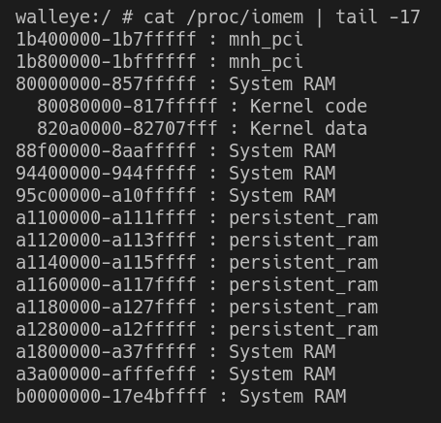
Linux kernel physical addresses
I want to whitelist the entire Linux kernel physical memory, so I need to know what its addresses are
This can be queried through /proc/iomem
These addresses are always the same, even after a reboot

Slide 50
Whitelisting the entire kernel memory
(Very briefly)
Through overlapping whitelist entries, I achieve an item in a whitelist array whose address is 0 and whose size is bigger than the addresses of the kernel memory

Slide 51
Whitelisting the entire kernel memory
11 22 33 44 00 00 00 00 00 00 00 00 fe fe fe fe
00 00 00 00 01 00 00 00 55 66 77 88 99 aa bb cc
00 00 00 00 00 00 00 00 00 00 00 00 00 00 00 00
00 00 00 00 00 00 00 00 00 00 00 00 00 00 00 00
Input buffer before ioctl
Non-contiguous ION fd
Contiguous ION fd (address > kernel)
offset = 0x24
offset = 0x28
Contiguous ION fd
offset = 0x20

Slide 52
Whitelisting the entire kernel memory
11 22 33 44 00 00 00 00 00 00 00 00 fe fe fe fe
00 00 00 00 01 00 00 00 55 66 77 88 99 aa bb cc
00 00 00 00 88 88 88 88 00 00 00 00 00 10 00 00
ef be ad de 00 00 00 00 00 10 00 00 00 00 00 00
Input buffer during ioctl
Contiguous ION fd (address > kernel)
offset = 0x28
Contiguous ION fd
offset = 0x20
Notes:
0x88888888 and 0xdeadbeef can change, but the important thing is the zeroes in the high 4 bytes

Slide 53
Whitelisting the entire kernel memory
11 22 33 44 00 00 00 00 00 00 00 00 fe fe fe fe
00 00 00 00 01 00 00 00 55 66 77 88 99 aa bb cc
00 00 00 00 88 88 88 88 00 00 00 00 00 00 00 fe
00 00 00 00 00 00 00 00 00 10 00 00 00 00 00 00
Input buffer during ioctl
Contiguous ION fd
offset = 0x20

Slide 54
Whitelisting the entire kernel memory
11 22 33 44 00 00 00 00 00 00 00 00 fe fe fe fe
00 00 00 00 01 00 00 00 55 66 77 88 99 aa bb cc
00 00 00 fe 00 00 00 00 00 00 00 00 00 00 00 fe
00 00 00 00 00 00 00 00 00 10 00 00 00 00 00 00
Input buffer after ioctl
Non-contiguous Whitelist entry
offset = 0x24
count = 2
Notes:
We’ll get other whitelist entries, but this is the only relevant one

Slide 55
Whitelisting the entire kernel memory
11 22 33 44 00 00 00 00 00 00 00 00 fe fe fe fe
00 00 00 00 01 00 00 00 55 66 77 88 99 aa bb cc
00 00 00 fe 00 00 00 00 00 00 00 00 00 00 00 fe
00 00 00 00 00 00 00 00 00 10 00 00 00 00 00 00
Input buffer after ioctl
address = 0
size = 0xfe000000

Slide 56
Building an exploit: The next step
I have the entire kernel memory whitelisted
Now all I needed is to find a functionality in a trustlet to get read + write
Turned out to be quite a challenge

Slide 57
Building an exploit: Using Widevine
(Very briefly)
The Widevine trustlet (used for DRM) has arbitrary encrypt/decrypt operations
I converted these into arbitrary read+write
Encrypt + Decrypt (with a symmetrical key) = Copy

Slide 58
Arbitrary kernel physical addresses read + write
I have arbitrary kernel read + write
Since physical addresses are not randomized, I can look for the physical address of data I want to modify and write data there.
As long as the kernel build is the same, the physical address of this data will always be the same
But what if I don’t want to look for physical addresses in different kernel builds?
Notes:
For example: SELinux bit

Slide 59
Linux kallsyms
kallsyms is a mechanism of the Linux kernel which keeps track of the virtual addresses of all symbols in the kernel
The data is kept in the kernel, but can be accessed from user-mode through /proc/kallsyms (only with root, of course)
Using my arbitrary memory access, I can search the kernel data for the kallsyms data. Then, I can parse it in order to extract the virtual addresses of every symbol I want.
kallsyms also keeps track of the kernel virtual address, which I can use in order to determine the physical address of a virtual address
With this, the exploit should work on every device/version

Slide 60
Takeaways
Notes:
The hardcore technical part is over

Slide 61
Why this exploit is powerful
Doesn’t depend on any timing/race issues, so 100% reliable
Data-based exploit, so bypasses mitigations related to code executions, e.g. DEP, CFI, PXN (SMEP), Stack canary, Shadow stack
Access through physical addresses, which bypasses mitigations that use virtual memory, e.g. ASLR, PAN (SMAP)
Should also bypass future virtual memory mitigation: MTE (memory tagging)
Unlike most kernel exploits these days, doesn’t need to be adapted per kernel build/version
Access through physical addresses means we can even modify read-only memory just as easy as read-write memory
Notes:
Although I obviously can’t test that it bypasses MTE, there really is every reason that it should

Slide 62
Takeaways
Exploits around physical memory addresses are extremely powerful
Perhaps this could be an interesting avenue to explore, especially if you wish to create stable exploits that don’t need to be adapted per device/version
As far as I know, the main recent research in Android which used physical memory access was done through the GPU:
CVE-2019-10567 by Guan Gong
CVE-2020-11179 by Ben Hawkes
CVE-2022-20186 by Man Yue Mo

Slide 63
Takeaways - Physical memory read+write
Quote from Ben Hawkes (Project Zero) analysis of in-the-wild CVE-2021-1905 exploit:
In this case it's hard to say if the attack would have proceeded with the classical memory corruption route (e.g. using the freed object to achieve arbitrary R/W), or with a GPU specific approach (such as granting arbitrary physical memory R/W to an attacker controlled GPU context). If the former approach, then upcoming memory tagging designs would likely help. The latter approach would require further study.

Slide 64
Takeaways - Physical memory read+write
Quote from Ben Hawkes (Project Zero) analysis of in-the-wild CVE-2021-1905 exploit:
In this case it's hard to say if the attack would have proceeded with the classical memory corruption route (e.g. using the freed object to achieve arbitrary R/W), or with a GPU specific approach (such as granting arbitrary physical memory R/W to an attacker controlled GPU context). If the former approach, then upcoming memory tagging designs would likely help. The latter approach would require further study.

Slide 65
Takeaways - Physical memory read+write
Quote from Ben Hawkes (Project Zero) analysis of in-the-wild CVE-2021-1905 exploit:
In this case it's hard to say if the attack would have proceeded with the classical memory corruption route (e.g. using the freed object to achieve arbitrary R/W), or with a GPU specific approach (such as granting arbitrary physical memory R/W to an attacker controlled GPU context). If the former approach, then upcoming memory tagging designs would likely help. The latter approach would require further study.

Slide 66
Takeaways
Research into QSEE is relatively rare
While some relevant code is open source (QSEECom in the Linux kernel), the other side (QSEE) is not
This presentation thoroughly documents the basic communication protocol between the Normal World and QSEE, which is not actually that well documented
Notes:
I think perhaps one of the reasons this bug was not found before is that the other side (QSEE) is closed source

Slide 67
Bug report timeline
October 31 2020: Vulnerability + exploit reported to Google
November 4 2020: Google say they forwarded the report to Qualcomm
December 8 2020: Google say they were able to reproduce the issue and are working with Qualcomm to fix it
December 17 2020: Google say they think the vulnerability will be fixed by February or March
April 23 2021: Google say the fix took time due to Qualcomm’s policy, and that it is scheduled for September 7th.
September 7 2021: The fix is published as part of the Android September security bulletin

Slide 68
Questions?

