Slide 1
A new secret stash for fileless malware.
Denis Legezo
Kaspersky, GReAT

Slide 2
Plan for the next 40 minutes
Typical logging… and shellcodes
Why not to combine them?
Anti-detect techniques
Several last stagers
Third-party tools

Slide 3
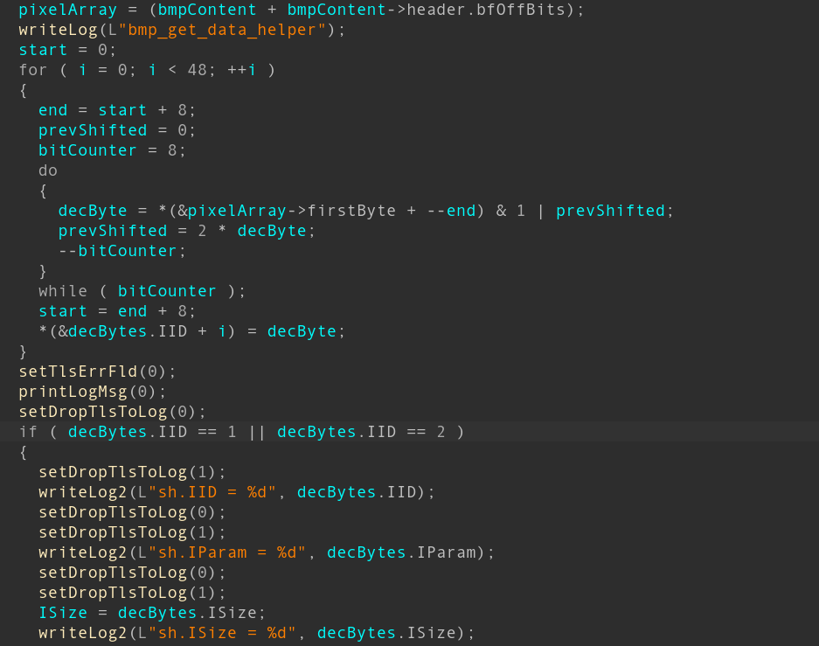
Typical logging
Developers use print-like debugging
Keep debug removing as TODO
Operators want to check execution flaw
Which stages were successful

Slide 4
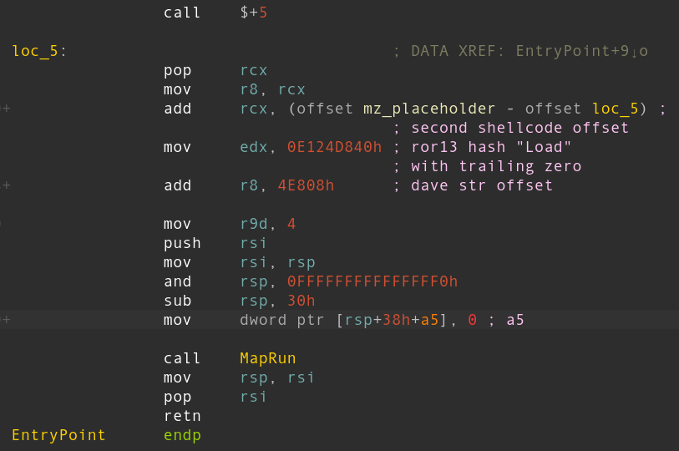
..and shellcodes
Position independent
Leads to get self RVA tricks
Loader independent
Leads to PEB and PE parsing
Hashes instead of func names

Slide 5
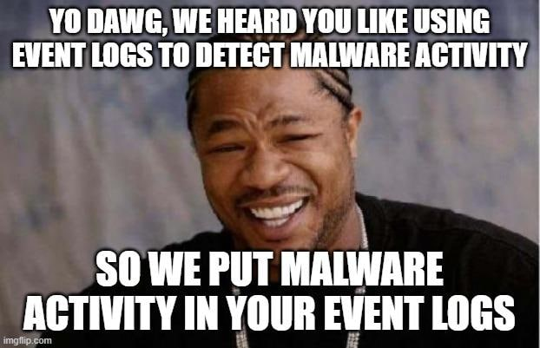
Why not to combine?
Windows event logs (.evtx) could contain binary data
It’s a legit mechanism
Drivers write minidumps where, etc.
Looks like a place for shellcodes as well

Slide 6
Show me the code

Slide 7
Read and put into container

Slide 8
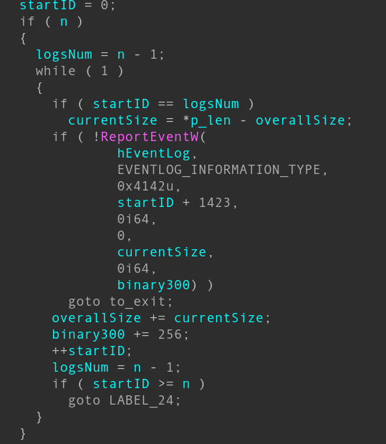
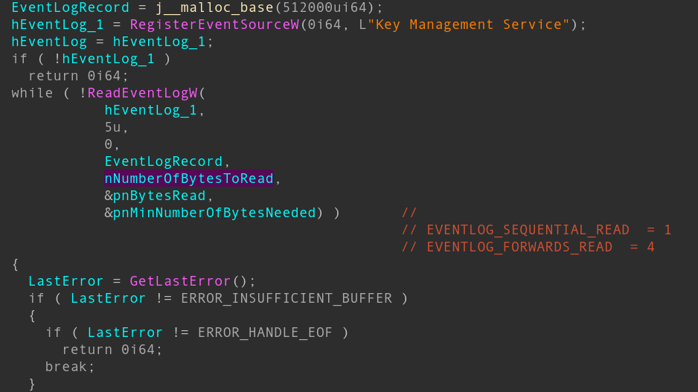
What about writing them

Slide 9
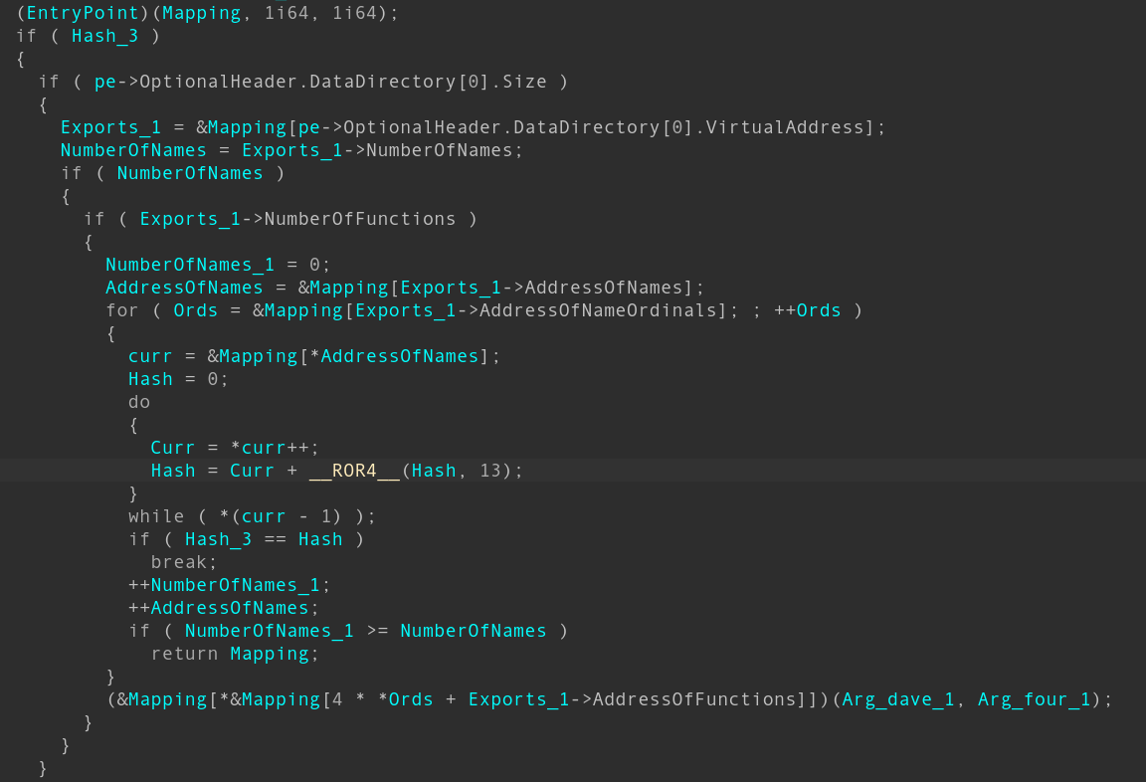
Inside the shellcode

Slide 11
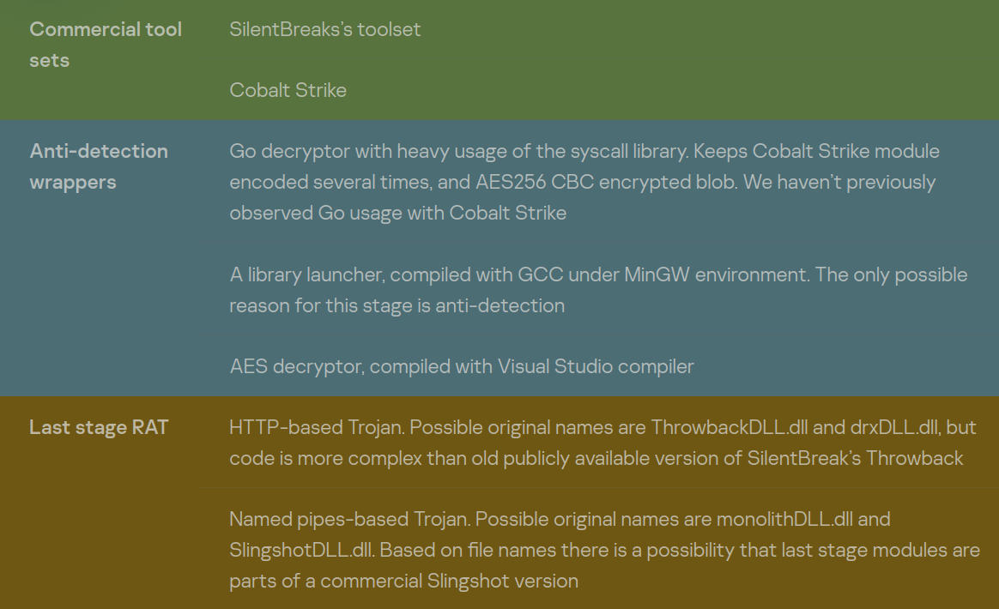
Birds eye view
Throwback trace is visible
Go, gcc, even Nim compilers
Named pipes for LAN
HTTP-based for remote

Slide 12
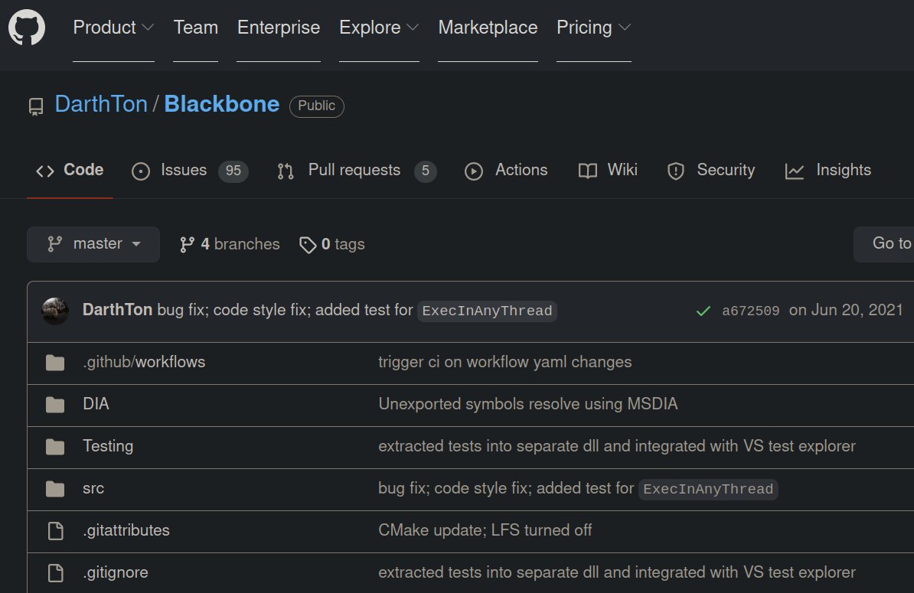
Third-party tools
Free and commercial
Github usage all the time
Two commercial suites simultaneously aren’t typical

Slide 13
Typical Blackbone trampoline

Slide 14
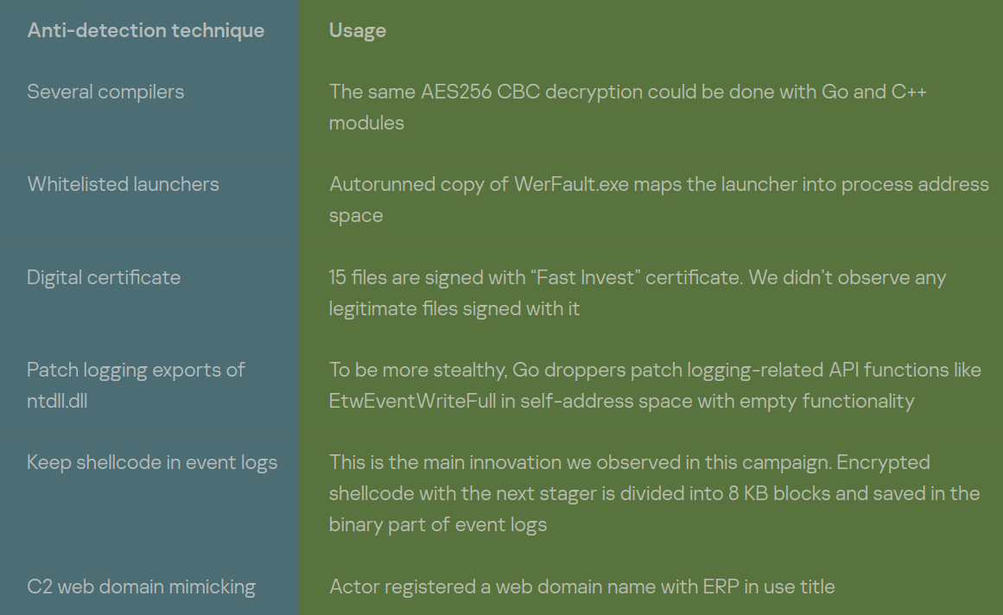
Anti-detection
Patching
Sideloading
Digital certificate
Esoteric compilers

Slide 15
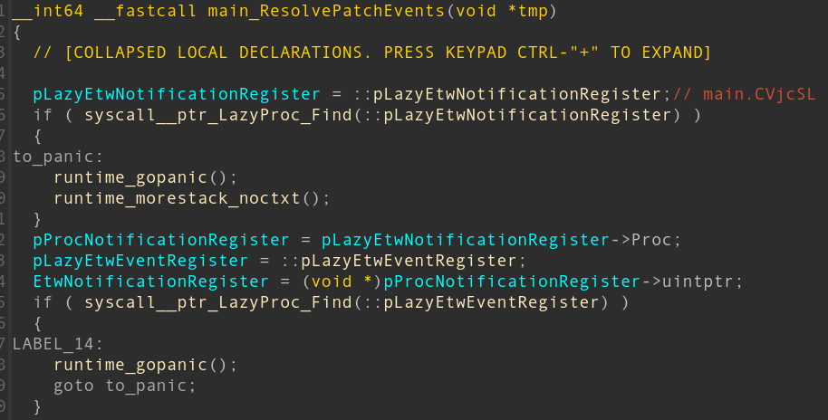
Patching
Authors like only their logs
EtwNotificationRegister, EtwEventRegister, etc. are patched to return(0)
AMSI-related functions are patched either
This part is commodity already

Slide 16
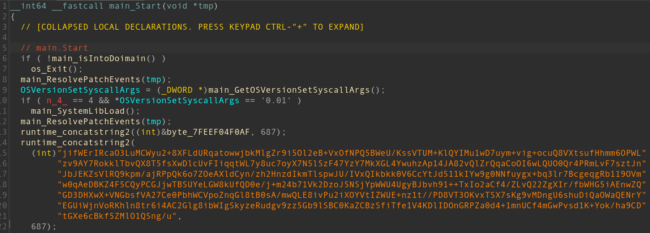
Go wrapper for Cobalt

Slide 17
And patching with Go

Slide 18
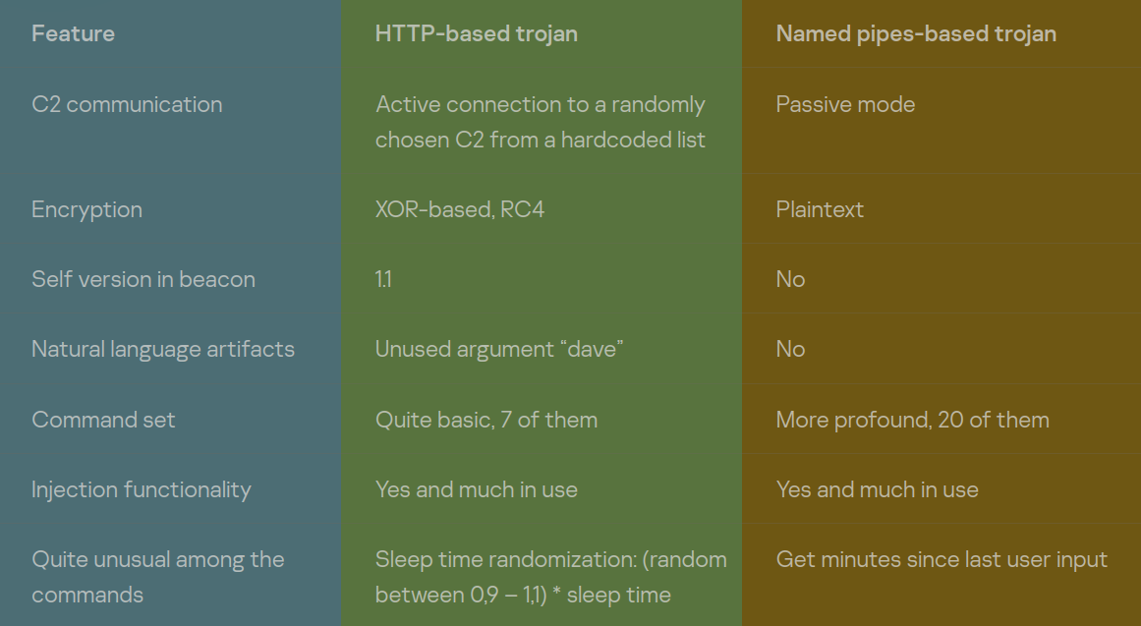
Several last stagers
Passive version
Love for injection
“Is user active now?”
Sleep time randomization

Slide 19
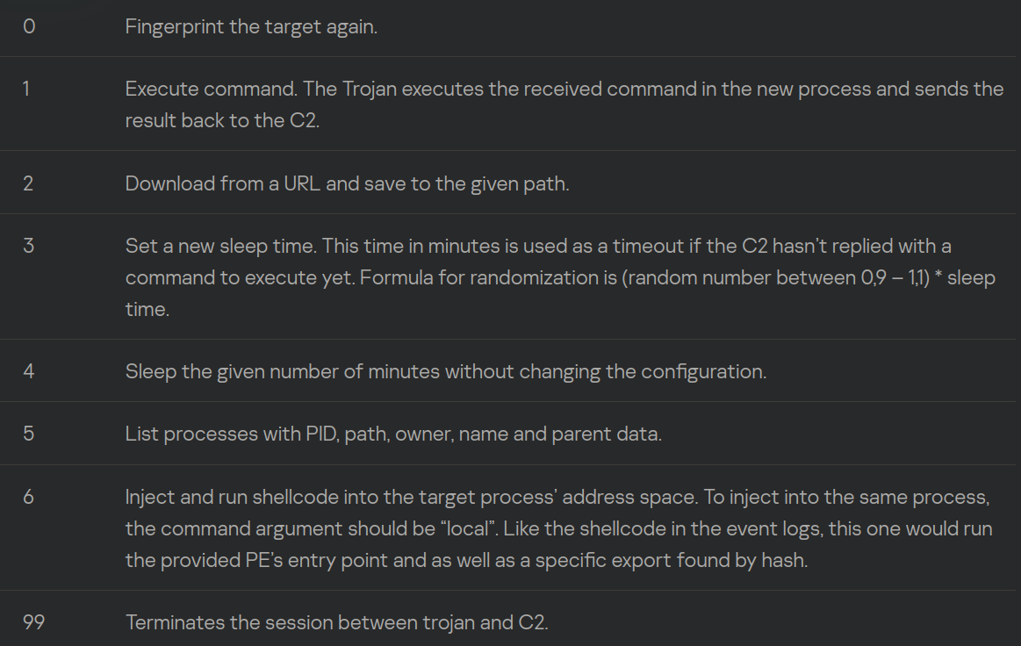
HTTP trojan version
Random C2 from the list
MachineGUID, SeDebugPrivilege among the fingerprinting of target
Throwback-like encryption
Short command system

Slide 20
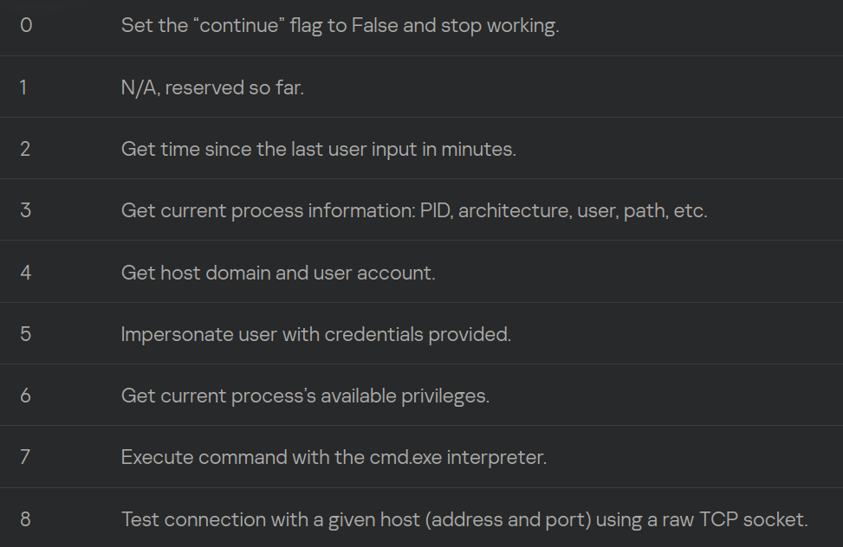
Pipes trojan version
Monolith named pipe
Hardcoded RC4 key
More profound command system
HTTP version with such commands also exists

Slide 21
Questions time!
Denis Legezo
@legezo

Slide 22
Questions time!
Denis Legezo
@legezo

