Slide 1
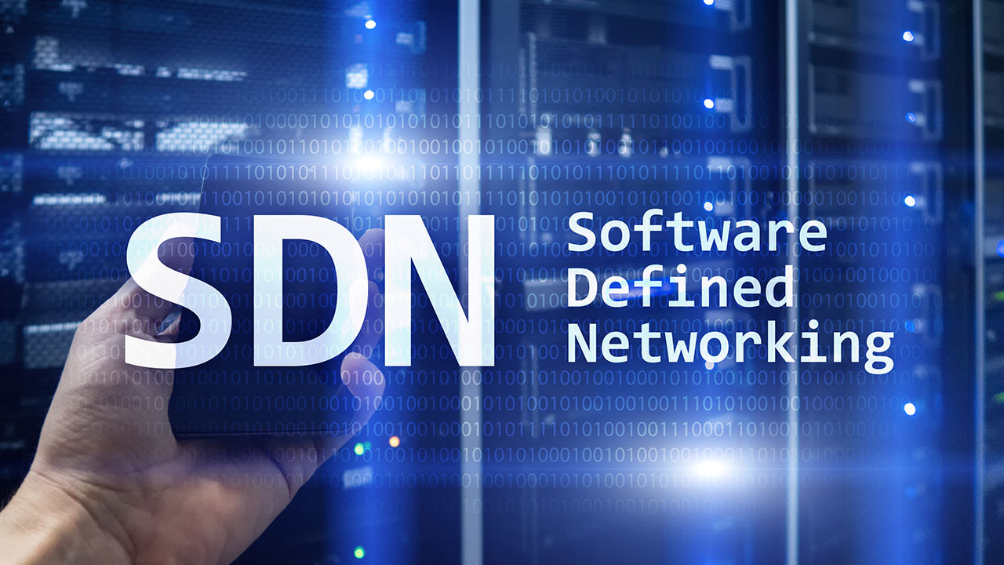
SOFTWARE DEFINED SNORT WITH BARNYARD and PULLEDPORK for NIDPS.

Slide 2
Hello!
Arun Samuel
Solution Advisor – Cyber Risk Advisory – Deloitte USI
External Researcher – UMD
Associate – NCDRC
Lead - National Information Security Council

Slide 3
Brief Defn:
SDN and OpenFlow
Mininet and Controller
Snort and dependencies
Defender’s Mechanisms
Vendor & OEM Controls
End Goals & Future Scope

Slide 4
Architecture View
The Flow

Slide 5
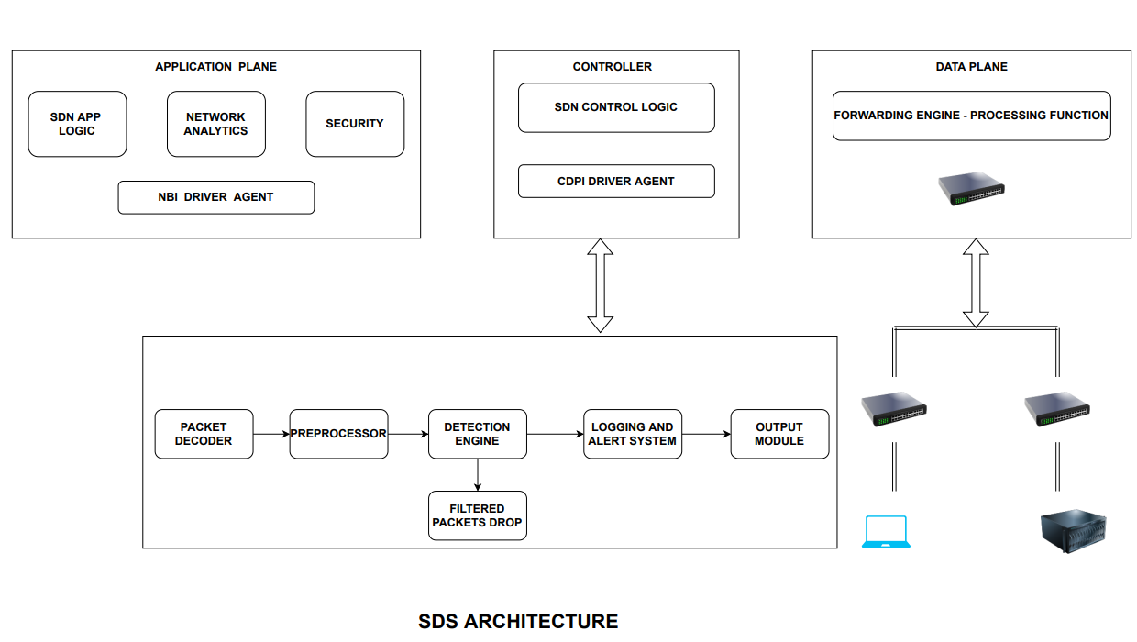

Slide 6
SDN and OpenFlow:
Using a management switch to decouple the planes and program the network traffic / data transmission.
Open-Flow manages the flow control in SDN and that specifies how the controller and the switches communicate.
Mininet:
Mininet is a network emulator which creates a network of virtual hosts, interfaces and links. Mininet hosts run standard Linux network software. A simple ping from h1 to h2 with the virtual interface during the transmission. We will be creating a network environment with OVS.
Floodlight / RYU:
Floodlight is an SDN controller. It is an apache-licenced Open-source works with both NBI and SBO. Module applications runs long with the controller.

Slide 7
Snort:
Intrusion Detection Engine that works on a single-threaded application.
Barnyard:
Barnyard2 is an open-source interpreter for Snort’s output plugin. It would read files from its front end that snort generates. Limited database support. Three modes of transmission: Batch, Continual and Continual with bookmarking. Its primary use is allowing Snort to write to disk in an efficient manner and leaving the task of parsing binary data into various formats to a separate process that will not cause Snort to miss network traffic.

Slide 8
PulledPork:
As we need to update the snort rules frequently based on the public repository or a zero day that may arise, We could use pulledpork scripts for implementing and updating those in the clients and server side. It will give the stability to make the rule effective that pulls, and it will detect the snort based on the binary format. In other words, it’s a rule manager for snort in-short .
Open vSwitch:
The main purpose of Open vSwitch is to provide a switching stack for hardware virtualization environments, while supporting multiple protocols and standards used in computer networks.
Open vSwitch can operate both as a software-based network switch running within the virtual machine (VM) hypervisors, and as the control stack for dedicated switching hardware

Slide 9
Defender’s Mechanism:
Customization – Control Plane
Customization – Data Plane

Slide 10
Customization – Control Plane ( Switch way)
Mininet with a Controller
Types of Control
The way of learning switch algorithm at each hop

Slide 11
Customization – Control Plane ( Firewall way)
Same as Switch
Source MAC Address – Rule addition
Requirements to fulfil
Cache Decisions at Layer 2
Turn your switch to firewall
OSGi Interface & Life of a Packet

Slide 12
Customization – Data Plane
Not flexible as software
Speed and run in parallel with existing protocols
Custom software
Custom hardware
Intel DPDK & Optimization Matters

Slide 13
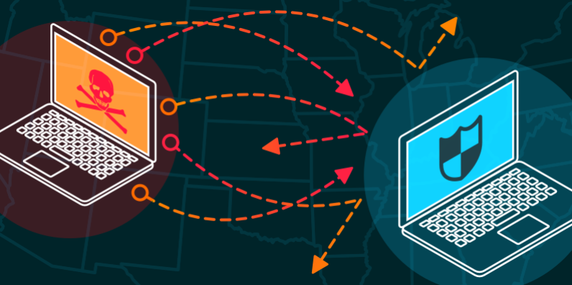
Vendors and OEMs:
Volumetric
Protocol
Application
Custom Insertions

Slide 14
End Goals and Future Scope :
Without Manual Intervention
DDoS Defensive Integrations
Unified Security Products for Infrastructure

Slide 15
Thanks!
Q & A You can find me at:
arunthelegion
arun-samuel-94351956

