Slide 1
Vajra
Your Weapon To cloud

Slide 2
Raunak Parmar
Raunak Parmar is an information security professional whose areas of interest include web penetration testing, Azure/AWS security, source code review, scripting, and development.
He has 2+ years of experience in information security. Raunak likes to research new attack methodologies and create open-source tools that can be used during the Cloud Security assessments. He has worked extensively on Azure and AWS.
He is the author of Vajra and 365-Stealer an offensive cloud security tool. He has spoken in multiple conferences and local meetups.
Social Media Links:
Twitter: https://twitter.com/trouble1_raunak
YouTube: https://www.youtube.com/channel/UCkJ_sEF8iUDXPCI3UL0DAcg
LinkedIn: https://www.linkedin.com/in/trouble1raunak/
GitHub: https://github.com/TROUBLE-1/

Slide 3
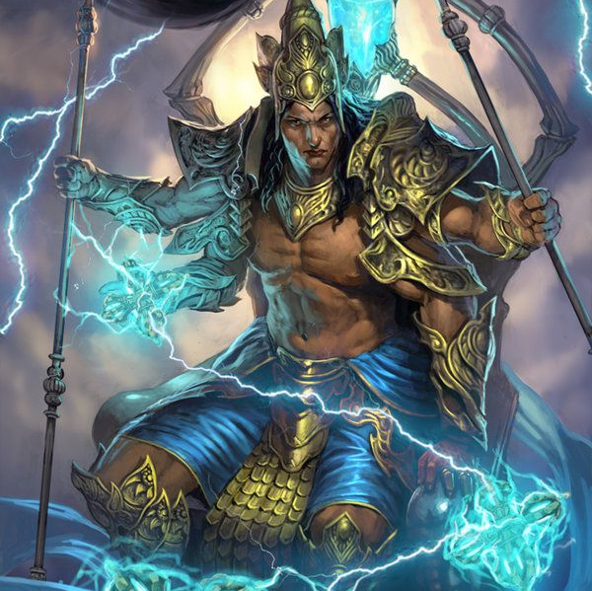
What is Vajra?
Vajra is a framework capable to validate the cloud security posture of the target environment.
The word Vajra refers to the Weapon of God Indra in Indian mythology (God of Thunder and Storms). Having it connected to the cloud makes it a perfect name for the tool.
Current Features are Specific to Azure and AWS.
The tool is currently under development, with more enumeration and attacking options planned for future releases and support for GCP as well.

Slide 4
Your weapon with different blades
Azure
AWS
Attacking
Phishing(illicit Consent Grant)
Spraying
Brute Force
Enumeration
Valid Users
Subdomain(Assets)
Azure Ad
Azure ARM
Enumeration
IAM Enumeration
S3 Scanner
Misconfiguration Review
!!More to come!!

Slide 5
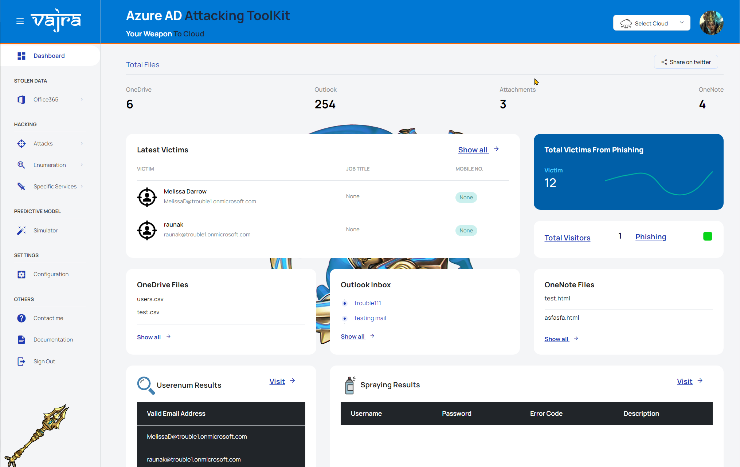

Slide 6
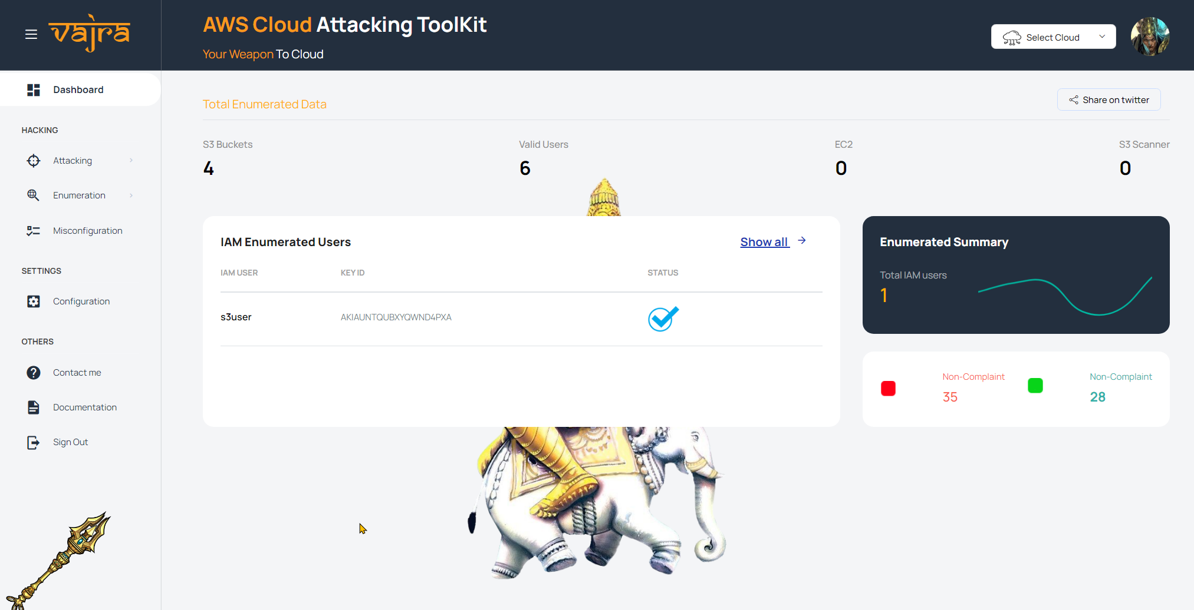

Slide 7
Real-Life Scenario

Slide 8
Initial Access
User Enumeration
Phishing
Spraying
Brute-Force

Slide 9
Demonstration

Slide 10
Thank You

